Slide 1

Presentation Software
Deena Sjoberg
CIS-101 Computer Information Systems
General Education Core

Slide 2

History of PowerPoint
CIS-101 Computer Information Systems
General Education Core

Slide 3

Microsoft PowerPoint
Released in 1987 by Microsoft after being purchased from Forethought, Inc. under the name “Presenter” which was originally designed for Macintosh.
Renamed to PowerPoint due to legal issues of using the name “Presenter”.
Forethought was purchased by Microsoft in 1990 and became their Graphics Business Unit.
PowerPoint was released the same day that Windows 3.0 was released.

Slide 4
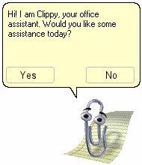
Microsoft PowerPoint
PowerPoint was a leader in its time of presentation software. There was not another software that was included in a package that could present information the same way.
PowerPoint has undergone many changes including getting rid of Clippy.
PowerPoint claimed approximately 95% of all market share with over 1 billion installations.

Slide 5
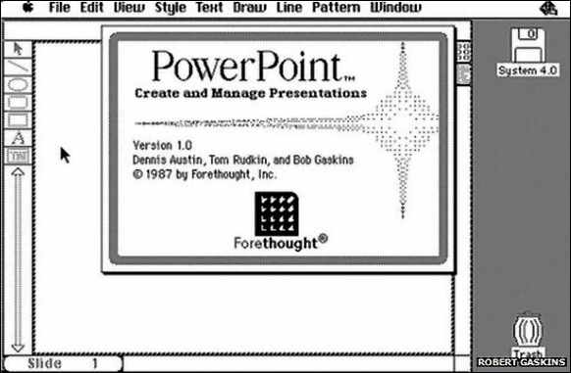
Microsoft PowerPoint

Slide 6
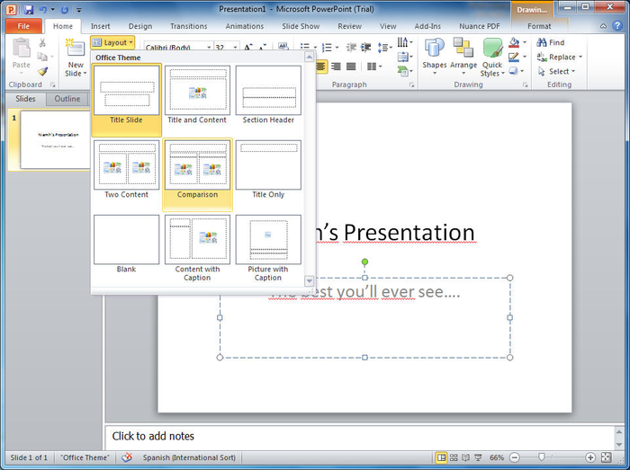
Microsoft PowerPoint

Slide 7
Terms for PowerPoint
CIS-101 Computer Information Systems
General Education Core

Slide 8
PowerPoint Terminology
Ribbon -
  an area at the top of an office program window that contains commands for working with the open file; the commands are organized under tabs.
Cursor –
  point on a display screen where the next character or space is entered.
Scroll Bar –
  appears at the bottom and/or right side of a window to allow a user to view another part of the window
Tabs –
  Buttons that are groups of functions inside of Office. (Home, Insert, Design, etc.)

Slide 9
PowerPoint Terminology
Presentation –
  a set of slides or handouts that contains information you want to convey to an audience.
Normal View –
  PowerPoint's default view that displays the Slide pane, the Notes pane, and the Slides/Outline pane.
Placeholders –
  Designated areas in PowerPoint layouts that can be used to easily insert text, graphics, or multimedia objects.

Slide 10
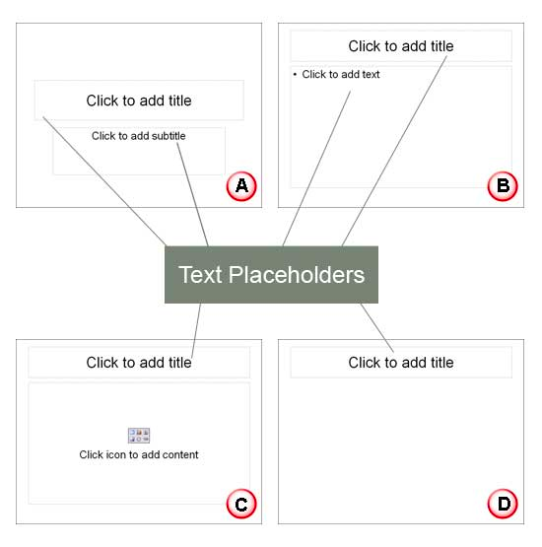
PowerPoint Terminology
Placeholders

Slide 11
PowerPoint Terminology
Active Slide –
  The slide currently selected or displayed.
Slide Layout –
  Prearranged sets of placeholders for various types of slide content.
Theme Formatting –
  feature that applies a background, colors, fonts, and effects to all slides in a presentation.
Clip Art –
  Pre-drawn artwork, photos, animations, and sound clips that you can insert into your files.

Slide 12
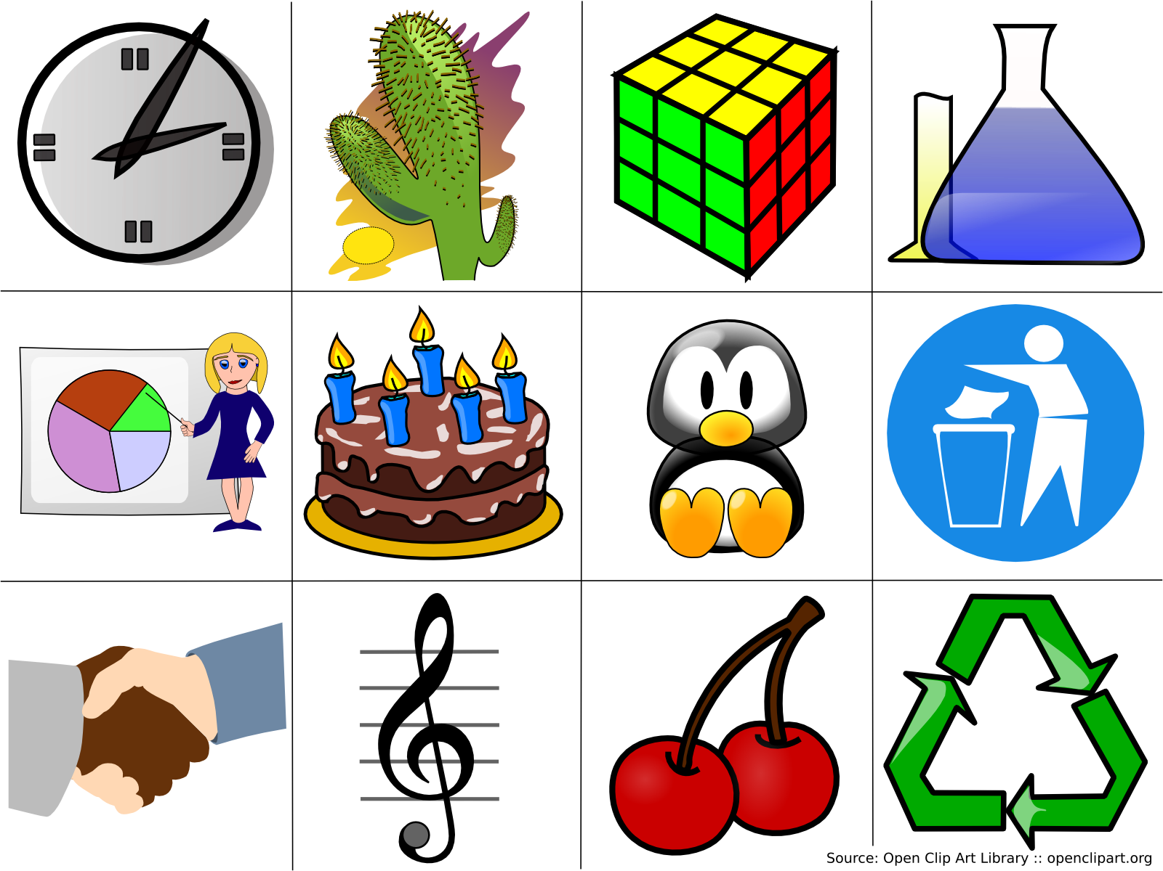
PowerPoint Terminology
Clip Art Vector Based

Slide 13
PowerPoint Terminology
Contextual Tab –
  a Ribbon tab that displays only when needed for a specific task such as formatting a table or offering picture formatting options.
Font –
  A set of characters with a specific size and style.
Template –
  A presentation that is already formatted with a slide design and may also include sample text to guide you in completing the presentation.
Footer –
  An area at the bottom of a slide in which you can enter a date, slide number, or other information.

Slide 14
PowerPoint Terminology
Header –
  An area at the top of a slide in which you can enter a date or other information that repeats for each page.
Handouts –
  Printed copies of the presentation for the audience to refer to during and after the slide show.
Landscape Orientation –
  A slide or printout that is wider than it is tall.
Portrait Orientation –
  A slide or printout that is taller than it is wide.

Slide 15
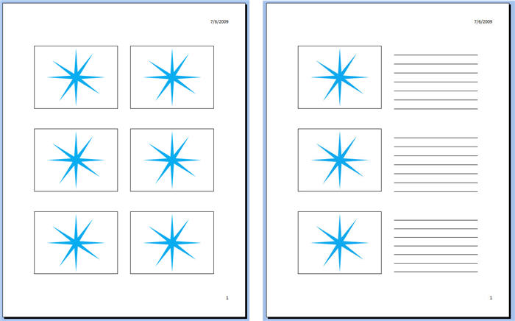
PowerPoint Terminology
Handouts Sample

Slide 16
PowerPoint Terminology
AutoFit PowerPoint –
  feature designed to reduce font size to fit text in the current placeholder.
SmartArt Graphics –
  Professionally designed graphics that organize and display information in various graphic types such as lists, processes, or hierarchical displays.
Crop –
  Remove a portion of a picture that you don't want
Scaling –
  Specifying a percentage of the original size to enlarge or reduce an object.

Slide 17
PowerPoint Terminology
Slide Master –
  A slide that contains the appearance of all slides in a presentation.
Template –
  A foundation on which to build a presentation; a template may contain theme colors, fonts, and effects, graphics, a background, and slide layouts.
Transitions –
  The visual effects used when one slide moves off of the screen and another moves onto the screen.
Advance Slide Timing –
  A setting that controls the amount of time a slide displays on the screen.

Slide 18
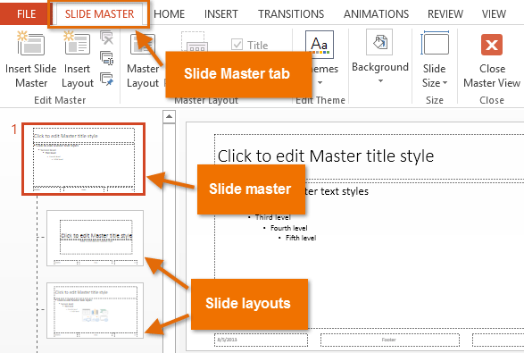
PowerPoint Terminology
Slide Master

Slide 19
PowerPoint Terminology
Animate –
  To apply movement to text or an object to control its display during the presentation.
Custom Show –
  A show in which you specify the slides and the order in which the slides appear during the presentation.

Slide 20
PowerPoint 2013 and Office 365
CIS-101 Computer Information Systems
General Education Core

Slide 21
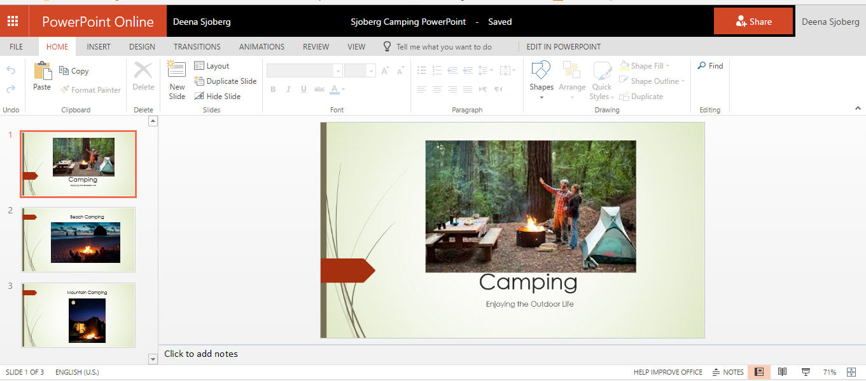

Slide 22
Questions?
CIS-101 Computer Information Systems
General Education Core

