Slide 1

Excel Basics
Deena Sjoberg
CIS-101 Computer Information Systems
General Education Core

Slide 2

History of Excel
CIS-101 Computer Information Systems
General Education Core

Slide 3

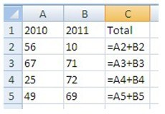
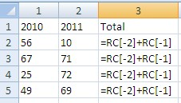
Microsoft Excel – Early History
The electronic spreadsheet was essentially invented in 1979 by software pioneer Dan Bricklin, who started up Software Arts with Bob Frankston and created VisiCalc.
Released in 1982 by Microsoft under the name of MultiPlan. Direct competitor to VisiCalc. https://www.quora.com/Who-conceptualized-Microsoft-Excel
VisiCalc worked under A1 Style vs. MultiPlan which worked under R1C1
A1 Style R1C1 Style

Slide 4
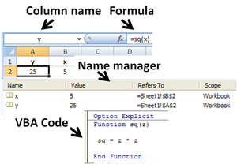
Microsoft Excel – Early History
Early history. Microsoft originally marketed a spreadsheet program called Multiplan in 1982.
Microsoft released the first version of Excel for the Macintosh on September 30, 1985, and the first Windows version was 2.05 (to synchronize with the Macintosh version 2.2) in November 1987
https://en.wikipedia.org/wiki/Microsoft_Excel

Slide 5
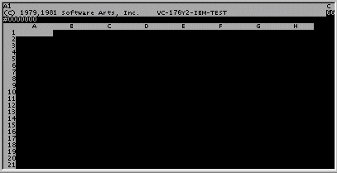
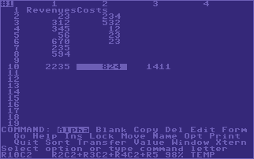
Microsoft Excel
MultiPlan did not take over Lotus 1-2-3 as expected. Microsoft decided to re-create and rebrand to Excel for Mac in 1985. Windows version in 1987.
VisiCalc was only able to do 5 Columns and 20 Rows of calculations. Excel can now do roughly 1 million rows by 17,000 columns. This is simply a programming limitation.

Slide 6
Microsoft Excel
Excel was the very first Microsoft Office Application.
Office was introduced to Mac first, not Windows.
There is no Excel 6.0. This was done to work towards putting on Office applications on the same version number.
Excel can be used for much more than just spreadsheets. Many people use it to create invoices, Gantt Charts, work process flows, and data clean up methods.

Slide 7
Microsoft Excel
Versions of Excel up to 7.0 had a limitation in the size of their data sets of 16K (214 = 16384) rows.
Versions 8.0 through 11.0 could handle 64K (216 = 65536) rows and256 columns (28 as label 'IV').
Version 12.0 can handle 1M (220 = 1048576) rows, and 16384 (214 as label 'XFD') columns.
The latest version of Excel has 16,384 columns and 1,048,576 rows
https://www.quora.com/How-many-rows-and-columns-in-one-excel-sheet

Slide 8
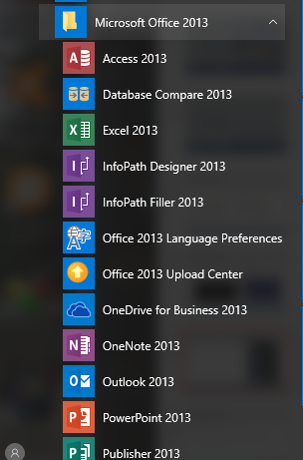
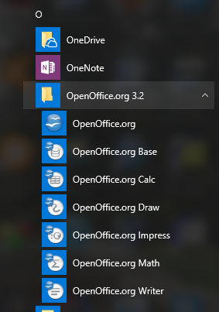
Microsoft Excel vs Open Office Calc
sss

Slide 9
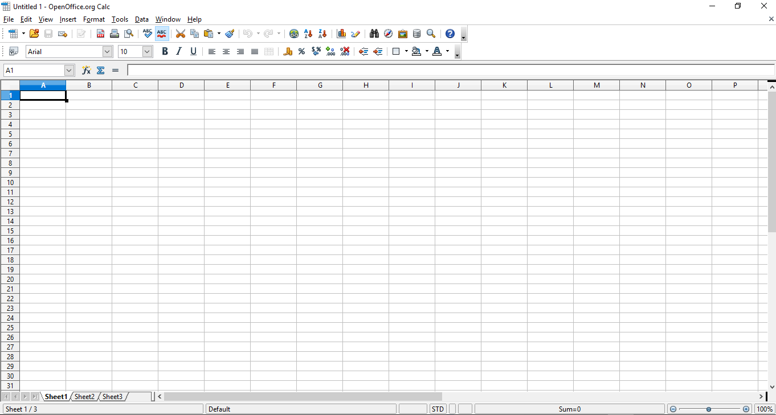
Open Office Calc

Slide 10

Apache OpenOffice
The Apache Software Foundation
https://www.openoffice.org/download/
Also Office X
www.officex.org/Free/Download‎

Slide 11
Terms for Microsoft Excel
CIS-101 Computer Information Systems
General Education Core

Slide 12
Excel Terminology
Ribbon – an area at the top of an office program window that contains commands for working with the open file; the commands are organized under tabs.
Cursor – point on a display screen where the next character or space is entered.
Scroll Bar – appears at the bottom and/or right side of a window to allow a user to view another part of the window
Tabs – Buttons that are groups of functions inside of Office. (Home, Insert, Design, etc.)
Active Cell – an area at the top of an office program window that contains commands for working with the open file; the commands are organized under tabs.
Alignment – the way in which the contents of a cell are arranged (e.g. left, right, centered)

Slide 13
Excel Terminology
AutoComplete – the feature to complete data entry for a cell based on similar values in other cells in the same column.
AutoFill – the feature to extend a series of values based on the contents of a single cell.
AutoFilter – a feature to sort and display data based on a filtering criteria.
Cell – the box at the intersection of a row and a column.
Cell Range – a collection of cells that are related for some reason.
Cell Reference – a letter and number code such as B15, that identifies the row and column intersection of a cell.
Charts – Visual representation of data contained in a worksheet data.
Column – Cells that are on the same vertical line in a worksheet.
Conditional Formatting – cell formatting that is only applied when certain cell criteria are met.
Conditional Formula – a formula that calculates a value using one of two different expressions, depending on whether a third expression is true or false.
Dependents – ceIls containing formulas that use a value from another cell.

Slide 14
Excel Terminology
Embed – to insert an object such as a picture into a worksheet rather than linking it.
Error Code – a message that appears in a worksheet cell, describing a problem with a formula or a function.
Field – a column in a data list.
Fill Handle - the small square at the bottom right hand corner of a cell that is dragged to indicate other > cells that should hold values in the series defined by the active cell.
FillSeries – the ability to extend a series of values based on the contents of two cells, where the first cell has the starting value for the series and the second cell shows the increment.
Filter – a rule that Microsoft Excel uses to determine which worksheet rows to display.
Formats – predefined sets of characteristics that can be applied to cell contents.
Formula – an expression within a cell used to calculate a value.
Freeze – to fix cells that will remain at the top of a worksheet regardless of how far down the worksheet a user scrolls.
Function – a pre-programmed formula or routine that is built in to Microsoft Excel.

Slide 15
Excel Terminology
Landscape – a print format where the page is wider than it is high.
Link – a formula that causes a cell show the value of another cell.
Locked Cells – cells that cannot be modified or deleted when worksheet protection is applied.
Named Range – a group of related cells defined by a single name.
Pick From List – the ability to enter a value into a cell by choosing the value from the set of values already entered into cells in the same column.
Portrait – a print format where the page is higher than it is wide.
Precedents – cells that are referenced in a formula.
Range – a group of related cells.

Slide 16
Excel Terminology
Report – a special document with links to one or more worksheets from the same workbook.
Rows – cells that share the same horizontal line in a worksheet.
Sheet Tab – the indicator for a worksheet, located in the lower left corner of the workbook window.
Sort – to reorder the contents of a worksheet based on a specific criteria.
Split Line – a line that indicates which cells have been frozen at the top of a worksheet.
Workbook – the basic Microsoft Excel document, consisting of one or more worksheets.
Worksheet – a page in a Microsoft Excel workbook.
Workspace – a Microsoft Excel file type (.xlw) that allows you to open several files at once

Slide 17
Features in Excel 2016
Go to: https://www.gcflearnfree.org/excel2016
CIS-101 Computer Information Systems
General Education Core

Slide 18
Questions?
CIS-101 Computer Information Systems
General Education Core

