Slide 1
Computer Operating System and Utilities
Deena Sjoberg
Week 1 B
CIS-101 Computer Information Systems
General Education Core

Slide 2
System Software Topics
OS role:
  Providing user interaction
  Managing the processor
  Managing memory
  Managing hardware
  Interacting with application software
  Starting the computer
Notes:
Chapter topics include:
System software
Kinds of OSs
OS role in:
Providing user interaction
Managing the processor
Managing memory
Managing hardware
Interacting with application software
Starting the computer

Slide 3
System Software: The OS
System software consists of two primary types of programs: the operating system and utility programs.
Controls computer functions
  Hardware
  Processor
  Memory
  Devices
Provides means for software to work with the CPU
Responsible for management, scheduling, and interaction of tasks
Provides user interface
The operating system (OS) is the main program that controls how your computer system functions.
Notes:
System software consists of two primary types of programs: the operating system and utility programs.
The operating system (OS) is the main program that controls how your computer system functions. The OS manages the computer’s hardware, including the processor, memory, and storage devices, as well as peripheral devices. The operating system also provides a consistent means for software applications to work with the CPU. Additionally, it is responsible for the management, scheduling, and interaction of tasks. Your first interaction with the OS is the user interface.

Slide 4
System Software: Utilities
Utilities: Programs that perform computer housekeeping tasks
  Manage system resources
  Improve efficiency
  Virus prevention
System software also includes utility programs.
Notes:
System software also includes utility programs. These are small programs that perform many of the general housekeeping tasks for the computer, such as system maintenance and file compression.

Slide 5
Operating System Categories
Four categories:
  Real-time (RTOS)
  Single-user, single-task
  Single-user, multitask
  Multiuser
Notes:
Operating systems can be classified into four categories, depending on the number of users they service and the tasks they perform.
Real-time operating systems don’t require the intervention of any users at all.
Single-user, single-task operating systems are proprietary systems developed specifically for the devices they manage.
Single-user, multitask operating systems are available commercially for personal and business use.
Multiuser operating systems coordinate resources for many users on a network.

Slide 6
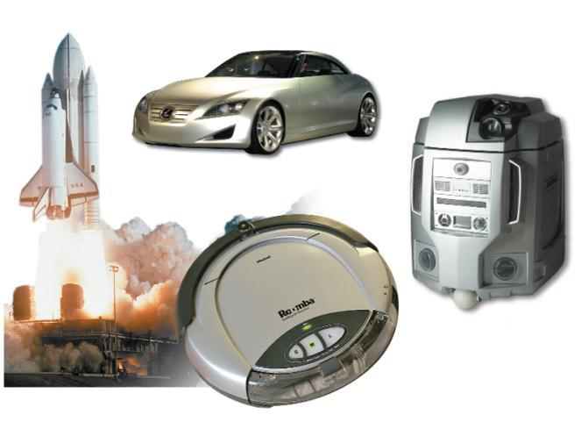
Real-Time Operating Systems
Performs a repetitive series of specific tasks in an exact amount of time
Systems with a specific purpose and a certain result
Uses include:
  Industrial machines
  Robotic devices
  Automobiles
  Video game consoles
  Home appliances
Notes:
Machinery that performs a repetitive series of specific tasks in an exact amount of time requires a real-time operating system.
This type of operating system is a program with a specific purpose.
For example, instruments such as those found in the scientific, defense, and aerospace industries that must perform regimented tasks or record precise results require real-time operating systems.
Real-time operating systems are also found in many types of robotic devices, fuel-injection systems in car engines, video game consoles, and home appliances.
Real-time operating systems require minimal user interaction. The programs are written specifically to the needs of the devices and their functions. Therefore, there are no commercially available standard RTOS software programs.

Slide 7
Operating Systems for
Servers and Mainframes
Servers
  Manage network resources
Mainframes
  Handle requests from hundreds or thousands of users simultaneously
Operating systems:
  Windows Server
  Unix
Servers are computers on a network that manage network resources, and mainframes are very large computers that handle the requests of hundreds or thousands of users simultaneously.
Notes:
Servers are computers on a network that manage network resources, and mainframes are very large computers that handle the requests of hundreds or thousands of users simultaneously.
Mainframe computers run operating systems developed by IBM and Unisys. The most common operating systems for running large servers and networks are Windows Server and Unix.

Slide 8
What the OS Does
Provides a user interface
Manages the CPU
Manages memory and storage
Manages hardware and peripheral devices
Coordinates application software with the CPU
Notes:
The operating system provides a way for the user to interact with the computer, manages the processor (CPU), manages the memory and storage, manages the computer system’s hardware and peripheral devices, and provides a consistent means for software applications to work with the CPU.

Slide 9
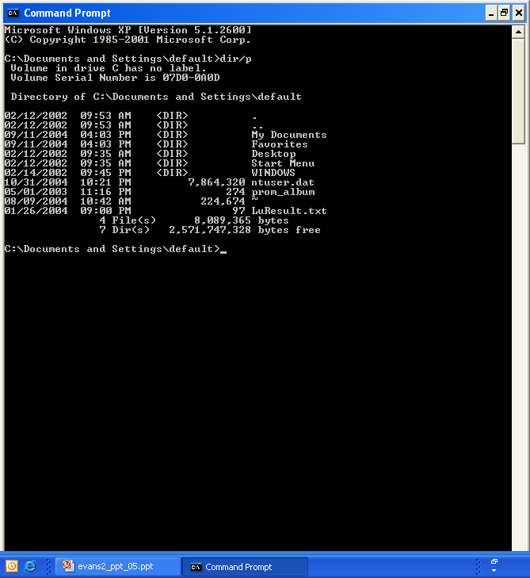
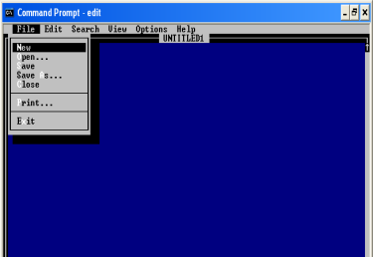
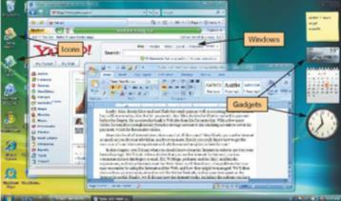
The User Interface
Command-driven
Enables you to interact with the computer
Types of interfaces:
  Command-driven interface
  Menu-driven interface
  Graphical user interface (GUI)
Most operating systems today use a graphical user interface - GUI.
Notes:
The OS provides a user interface that enables you to interact with the computer.
In early PCs, interaction with the OS was through a command-driven interface, meaning that the user had to type very specific commands to get the computer to load a program. The commands were not always easy to understand; therefore the interface proved to be too complicated for the average user.
The command-driven interface was later improved by incorporating a menu-driven interface in which the user chooses a command from menus displayed on the screen. Menu-driven interfaces eliminated the need to know every command because you could select most of the commonly used commands from a menu. However, they were still not easy enough for most people to use.
Most operating systems today use a graphical user interface. Unlike the command- and menu-driven interfaces used earlier, GUIs display graphics and use the point-and-click technology of the mouse and cursor, making operating systems much more user friendly.

Slide 10
Processor Management
Controls the timing of events the processor works on
  Interrupts
  Interrupt handler
  Interrupt table
  Stack
Notes:
Although the CPU is the brains of the computer, it needs the OS to arrange for the execution of all its activities in a systematic way.
To do so, the OS assigns a slice of its time to each activity requiring the CPU’s attention. The OS then switches between processes thousands of times a second so it appears that everything is happening seamlessly.
When the OS allows you to perform more than one task at a time, it is said to be multitasking.
The OS processes a task assigned a higher priority before processing a task that has been assigned a lower priority. This is called preemptive multitasking.
For example, assume you’re typing and you want to print a file. When you tell your computer to print the file, the printer generates a signal called an interrupt that tells the OS it is in need of attention.
Every device has its own type of interrupt, which is associated with an interrupt handler, a special numerical code that prioritizes the requests. These requests are placed in the interrupt table in RAM.
In our example, the OS pauses the CPU from its typing activity when it receives the interrupt from the printer and puts a “memo” in a special location in RAM called a stack. The memo is a reminder of where the CPU was before it left off so that it can work on the printer request.
The CPU then retrieves the printer request from the interrupt table and begins to process it. Upon completion of the printer request, the CPU goes back to the stack, retrieves the memo it placed about the typing activity, and returns to that task until it is interrupted again.

Slide 11
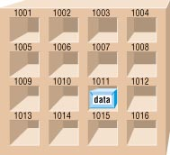
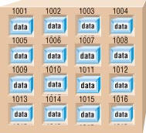

Memory and Storage Management
The operating system allocates space in RAM for instructions and data.
RAM
Operating System
Notes:
As the OS coordinates the activities of the processor, it uses RAM as a temporary storage area for instructions and data the processor needs.
The processor then accesses these instructions and data from RAM when it is ready to process them.
The OS is therefore responsible for coordinating the space allocations in RAM to ensure that there is enough space for all the waiting instructions and data.
It then clears the items from RAM when the processor no longer needs them.

Slide 12
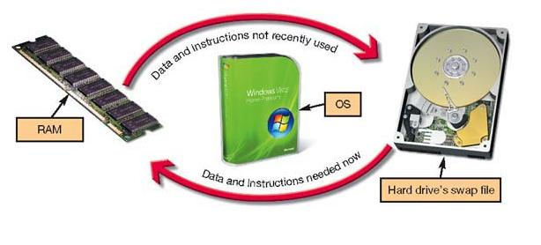
Virtual Memory
Instructions and data are stored on the hard drive when RAM is full.
  Swap file
  Paging
  Thrashing
Notes:
RAM has limited capacity. When there isn’t enough room in RAM for the OS to store the required data and instructions, it borrows room from the hard drive.
This process of optimizing RAM storage by borrowing hard drive space is called virtual memory.
When more RAM space is needed, the OS swaps out from RAM the data or instructions that have not been recently used and moves them to a temporary storage area on the hard drive called the swap file.
If the data and/or instructions in the swap file are needed later, the OS swaps them back into active RAM and replaces them in the hard drive’s swap file with less-active data or instructions. This process of swapping is known as paging.
Eventually your computer will become sluggish as it is forced to page more and more often. This condition of excessive paging is called thrashing.
The solution to this problem is to increase the amount of RAM in your system so that it can avoid having to send data and instructions to virtual memory.

Slide 13
Hardware and Peripheral
Device Management
Device drivers
  Programs that enable the operating system to communicate with peripheral devices
  Provided by the manufacturer of the device
Plug and Play
  Hardware and software standard
  Facilitates the installation of new hardware
Notes:
Each device attached to your computer comes with a special program, called a device driver, that facilitates the communication between the device and the OS.
The device driver translates the specialized commands of the device to commands that the OS can understand, and vice versa. Thus, devices will not function without the proper device driver because the OS would not know how to communicate with them.
Today, most devices come with the driver preinstalled in Windows. Devices whose drivers are included in Windows are called Plug and Play (PnP).
Plug and Play is not a driver. Instead, it is a software and hardware standard designed to facilitate the installation of a new piece of hardware in computers by including in the OS the driver the device needs to run.
Plug and Play enables users to plug their new device into a port on the system, turn on the system, and immediately use the device. The OS automatically recognizes the device and its driver.

Slide 14
Software Application Coordination
Application programming interfaces (APIs)
  Blocks of code contained in the operating system
  Coordinate the operating system with software applications
    Similar toolbars and menus
  Microsoft DirectX
Notes:
For software programs to work with a CPU, they must contain code that the CPU recognizes. Rather than having the same blocks of code for similar procedures in each software application, the OS includes the blocks of code that software applications need.
These blocks of code are called application programming interfaces (APIs).
To create programs that can communicate with the operating system, software programmers need only refer to the API code blocks in their individual application programs rather than including the entire code in the application itself. Not only do APIs avoid redundancies in software code, but they also make it easier for software developers to respond to changes in the OS.
Microsoft DirectX, for example, is a group of multimedia APIs built into the Windows operating system that improves graphics and sounds when you’re playing games or watching video on your PC.

Slide 15
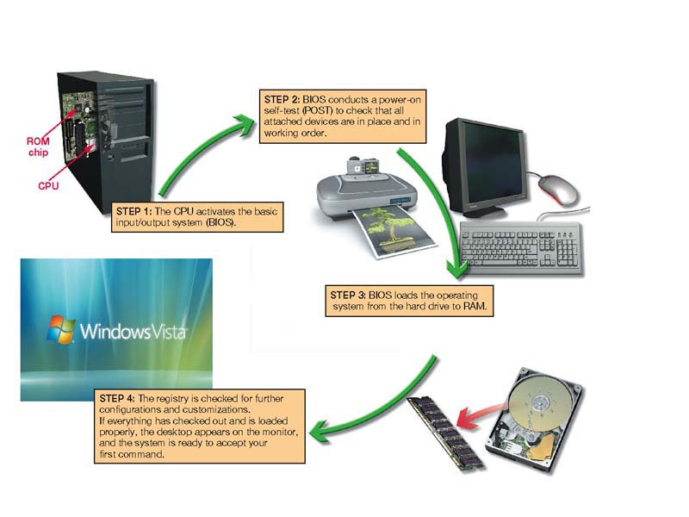
Starting the Computer
ROM Chip
The Boot Process
• Step 1: The basic input/output system (BIOS) is activated.
• Step 2: A power-on self-test (POST) checks attached hardware.
• Step 3: The operating system loads into RAM.
• Step 4: Configuration and customization settings are checked.
Notes:
For a computer to go from a dead stop to ready-for-use, a start-up process is required. This is often referred to as booting up the computer, or the boot process. The boot process consists of four basic steps:
1. The basic input/output system (BIOS) is activated by powering on the CPU.
2. The BIOS checks that all attached devices are in place (called a power-on self-test, or POST).
3. The operating system is loaded into RAM.
4. Configuration and customization settings are checked.
Once the boot process has completed these steps, the computer is ready to accept commands and data.

Slide 16
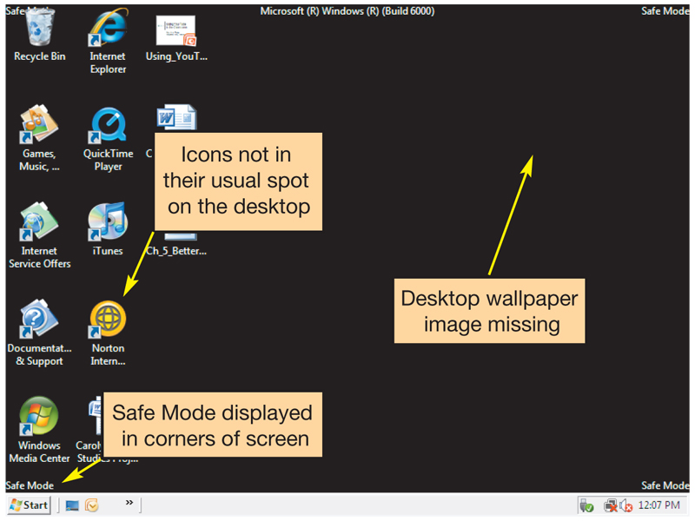
Handling Errors in the
Boot Process
Safe mode
  Windows does not boot properly
  Try rebooting
  Uninstall any new devices or software
Notes:
Errors during the boot process are often very simple to correct. It is helpful to be aware of the most common problems.
Sometimes Windows does not boot properly and you end up with a screen with the words Safe Mode in the corners. Safe mode is a special diagnostic mode designed for troubleshooting errors. While in Safe mode, only the essential devices of the system (such as the mouse, keyboard, and monitor) function. If, after you boot, you end up in Safe mode, try rebooting the machine before doing anything else. If you still end up in Safe mode and if you have recently installed new software or a new hardware device, try uninstalling it.

Slide 17
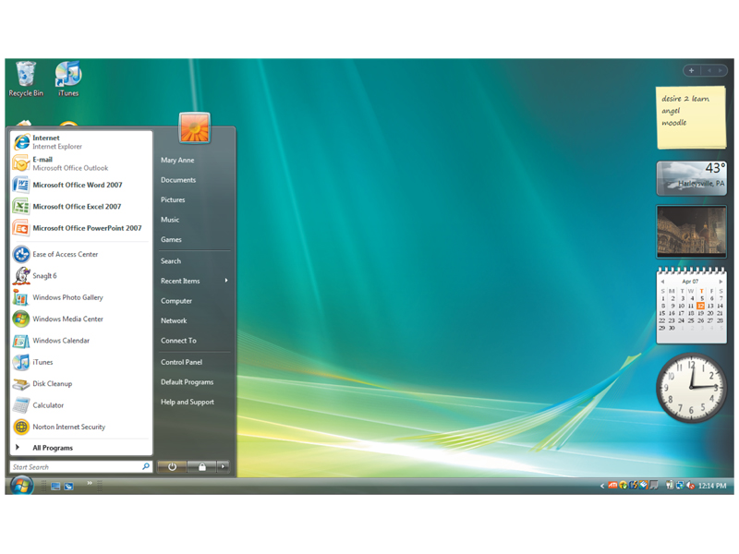
The Desktop
Notes:
The desktop is the first interaction you have with the OS and the first image you see on your monitor. As its name implies, your computer’s desktop puts at your fingertips all of the elements necessary for a productive work session that typically are found on or near the top of a traditional desk, such as files and folders.

Slide 18
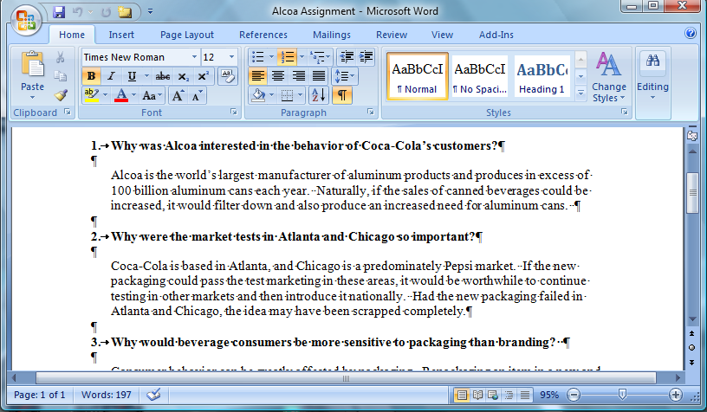
Windows
Title bar
Close button
Ribbon
Minimize button
Maximize/Restore button
Scrollbar
Document view options
Notes:
The standard window in Windows has consistent features. Once a user is familiar with the setup of these features, he or she will be immediately familiar with the windows in any Windows-based software. How many of the features can you name?
Title bar
Menu bar
Toolbar
Windows view options
Status bar
Scrollbars
Sizing buttons

Slide 19
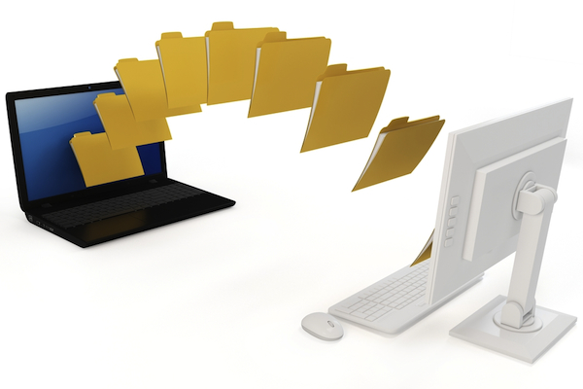
File Management
The operating system provides an organizational structure for the computer’s contents.
Hierarchical structure of directories:
  Drives
    Folders
      Subfolders
        Files
Notes:
An additional function of the OS is to enablefile management, which entails providing an organizational structure for the computer’s contents. The OS allows you to organize the contents of your computer in a hierarchical structure of directories that includes drives, folders, subfolders, and files.

Slide 20
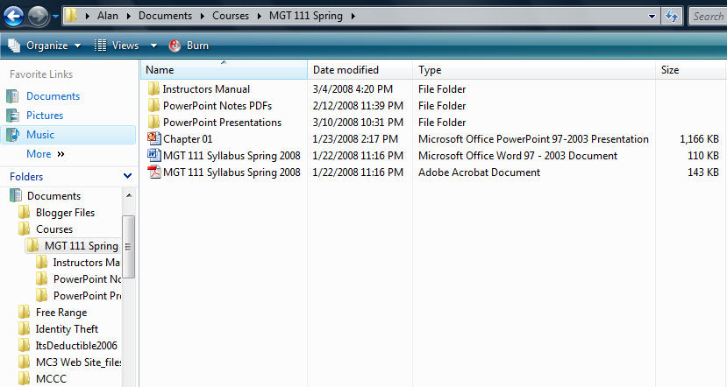
File Management
Files and folders inside MGT 111 Spring folder
Navigation pane with links to favorite folders
MGT 111 Spring folder selected
Folders presented in a hierarchical structure
Click to display the Searches Folder
Notes:
If you use a Windows PC, Windows Vista Explorer is the main tool for finding, viewing and managing the contents of your computer by showing the location and contents of every drive, folder, and file.

Slide 21
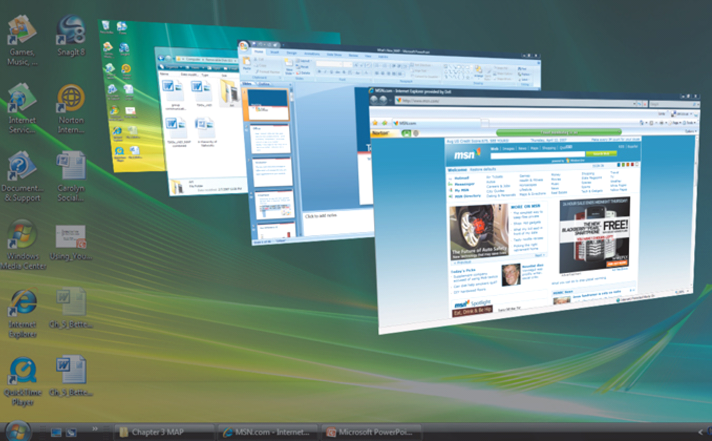
Viewing and Sorting
Files and Folders
Flip
3D
Notes:
Tiling windows is a great way to see two windows at the same time. Vista’s new Flip 3D gives you the ability to move through live images of open windows. You can also arrange windows in more traditional cascade, stacked, or side-by-side arrangements by right clicking an empty space on the taskbar.

Slide 22
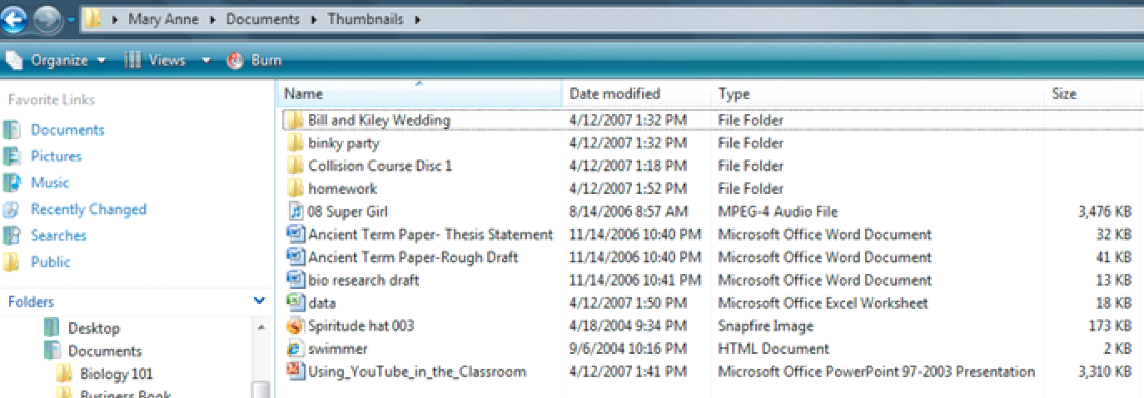
Viewing and Sorting
Files and Folders
Details view
Notes:
Details view is the most interactive view. Files and folders are displayed in list form, and the additional file information is displayed in columns alongside the filename. You can sort and display the contents of the folder by any of the column headings; you therefore can sort the contents alphabetically by filename or type, or hierarchically by date last modified or file size.

Slide 23
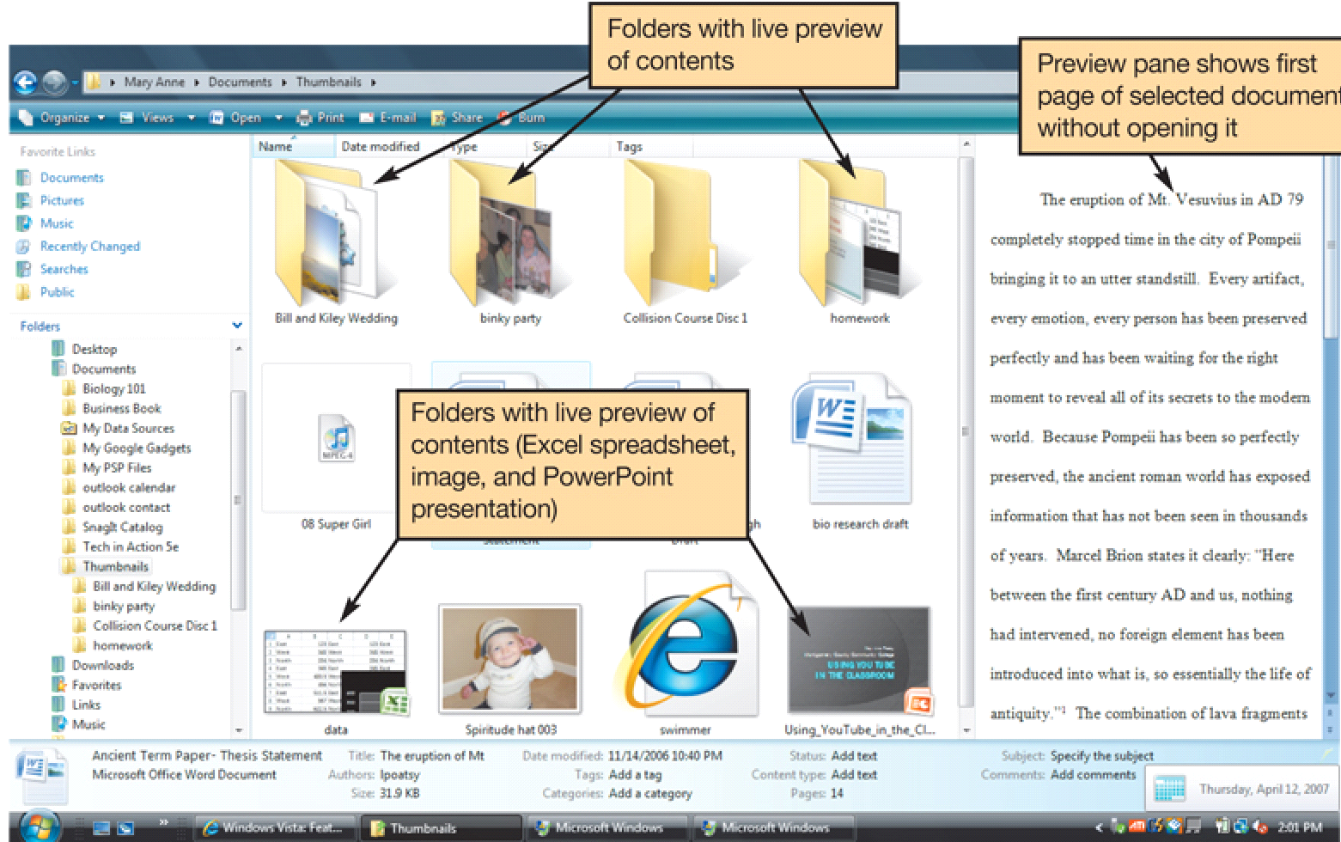
Viewing and Sorting
Files and Folders
Large
Icon
view
Notes:
In Windows Vista, Large Icon view replaces Thumbnails view in Windows XP. Large Icon view shows the contents of folders as small images.
There is also Extra Large Icon view, which shows folder contents and other icons as even larger images.
Large and Extra Large Icon views are best to use if your folder contains picture files. For those folders that contain collections of MP3 files, you can download the cover of the CD or an image of the artist to display on any folder to further identify that collection.

Slide 24
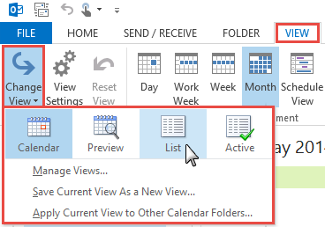
Viewing and Sorting
Files and Folders
Other views available:
  Tiles view
  List view
  Small and Medium Icons views
Notes:
Tiles view displays files and folders as icons in list form. Each icon includes the filename, the application associated with the file, and the file size. The display information is customizable. Tiles view also displays picture dimensions, a handy feature for Web-page developers.
List view is a display of even smaller icons and filenames. This is a good view if you have a lot of content in a folder and need to see most or all of it at once.
Small and Medium Icon views also display files and folders as icons in list form, but the icons are either small or medium sized and include no other file information than the filename. Additional file information is displayed in a ScreenTip, however.

Slide 25
Naming Files
Filename: Name assigned plus filename extension
Characters not legal in Windows filenames: “ / \ * ? < > | :
Character not legal in Mac filenames:
:
Bioreport.docx
or
Bio report.docx
Notes:
The first part of a file, or the filename, is the name you assign to the file when you save it. For example, “bioreport” may be the name you assign to a report you have completed for biology. If it was created in Works, it would be named bioreport.wks; if it was created in Word 2007, it would be named bioreport.docx.
Some characters are not legal in filenames.

Slide 26
Filename Extensions
Extension | Type of Document | Application
.doc | Word-processing document | Microsoft Word 2003
.docx | Word-processing document | Microsoft Word 2007 document
.wpd | Word-processing document | Corel WordPerfect
.xlsx | Spreadsheet | Microsoft Excel 2007 workbook
.accdb | Database | Microsoft Access 2007
.pptx | PowerPoint presentation | Microsoft PowerPoint 2007 presentation
.pdf | Portable Document Format | Adobe Acrobat or Adobe Reader
.rtf | Text | Any program that can read text documents
.txt | Text | Any program that can read text documents
Notes:
Following the filename and after the dot (.) comes an extension, or file type. This extension identifies what family of files the file belongs to or which application should be used to read the file.
For example, if the bioreport file is a Word 2003 document, it has a .doc extension and is named bioreport.doc. If the file is created in Word 2007, the file extension is .docx and is named bioreport.docx. All Word, Excel, and PowerPoint files created in the 2007 version have an “x” at the end of the traditional three-letter extension.

Slide 27
Filename Extensions (cont.)
Extension | Type of Document | Application
.htm or .html | Web page | Any program that can read HTML
.jpg | Joint Photographic Experts Group (JPEG) image | Most programs capable of displaying images
.gif | Graphic Interchange Format (GIF) image | Most programs capable of displaying images
.bmp | Bitmap image | Windows
.zip | Compressed file | WinZip

Slide 28
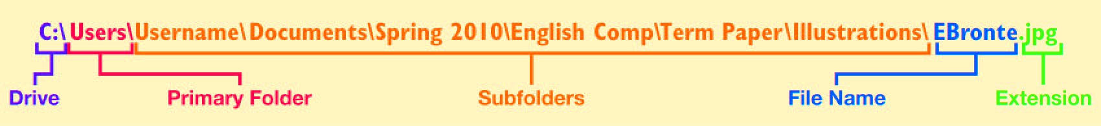
File Path
File path: Location of the file
Notes:
You can tell the location of a file by its file path. The file path starts with the drive in which the file is located and includes all folders, subfolders (if any), the filename, and the extension. For example, if you were saving a picture of Emily Brontë for a term paper for an English Comp course, the file path might be C:\My Documents\Spring 2009\English Comp\Term Paper\Illustrations\EBronte.jpg.

Slide 29
Working with Files
File management actions:
  Open
  Copy
  Move
  Rename
  Delete
Recycle Bin
Notes:
Once you’ve located your file with Windows Explorer, you can perform many other file management actions, such as opening, copying, moving, and deleting files.
You open a file by clicking the file in its storage location. The operating system then determines which application needs to be loaded to open the requested file and opens the file within the correct application automatically.
You can copy a file to another location using the Copy command. When you copy a file, a duplicate file is created and the original file remains in its original location.
To move a file from one location to another, you use the Move command. When you move a file, the original file is deleted from its original location.
The Recycle Bin is a folder on the desktop where files deleted from the hard drive reside until you permanently purge them from your system. Files in the recycle bin can be easily restored to their original location.
Files deleted from other drives, such as a floppy drive, CD, flash drive, or network drive, do not go to the Recycle Bin, but are deleted from the system immediately.

Slide 30
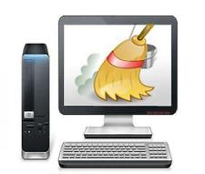
Utility Programs
Small programs that perform special functions:
  Manage system resources
  Create a pleasant environment
  Improve efficiency
Notes:
Utility programs are small applications that perform special functions.
Some utility programs (such as disk defragmenter utilities) manage system resources; others (such as screen savers) help make your time and work on the computer more pleasant; still others (such as file compression utilities) improve efficiency.

Slide 31
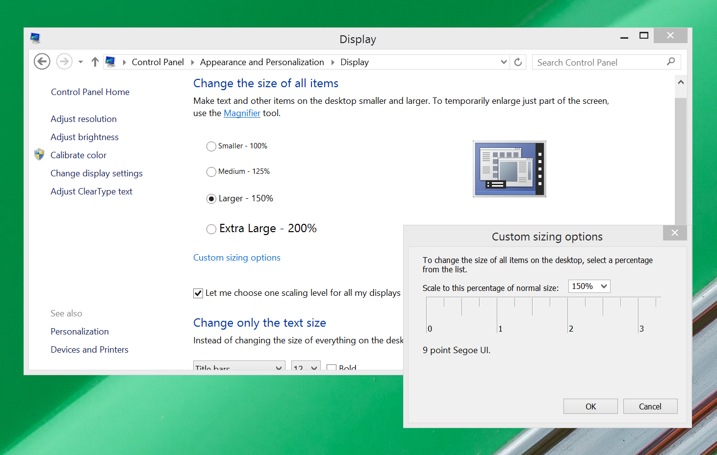
Display Utilities
Change the appearance of:
  Desktop
  Windows colors
  Font sizes
Include:
  Screen savers
  Screen resolution
  Clear Type
Notes:
Right clicking on an open area of the desktop opens the Display Properties dialogue box. This dialog box can also be accessed from the Control Panel using the Display icon. From here, you can adjust the look of your Windows environment, change screensavers, and even reset the resolution of the video.
Clear Type: Turning on this feature smoothes the edges of screen fonts to make text easier to read.

Slide 32
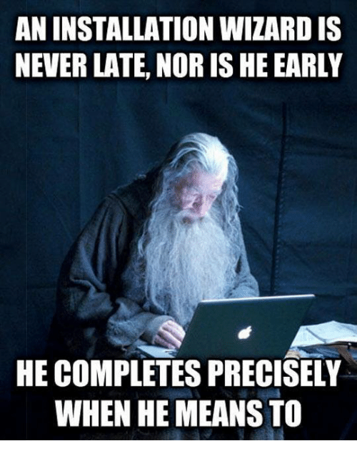
Add or Remove Programs
Installation wizard
Uninstall wizard:
  Programs cannot simply be deleted
Notes:
These days, when you install a new program, the program runs a wizard that walks you through the installation process. If a wizard does not initialize automatically, however, you should go to the Add or Remove Programs folder in the Control Panel. This prompts the OS to look for the setup program of the new software and starts the installation wizard.
Some people think that deleting a program from the Program Files folder on the C drive is the best way to remove a program from the system. However, most programs include support files that are not located in the main program folder. By selecting the Add or Remove Programs icon in Control Panel and choosing a particular program, you delete the main program file and all supporting files as well.

Slide 33
File Compression Utilities
Reduce the size of a file
Take out redundancies
Make it easier and faster to send files over the Internet
Generally, repeated patterns are replaced with a shorter placeholder
The rain in Spain falls mainly on the plain.
Notes:
A file compression utility is a program that takes out redundancies in a file to reduce the file size.
File compression is helpful because it makes a large file more compact, making it easier and faster to send over the Internet, upload to a Web page, or save onto a disk.
Windows Vista has built-in compression (or zip) file support.
There are also several stand-alone freeware and shareware programs, such as WinZip (for Windows) and StuffIt (for Windows or Mac), that you can obtain to compress your files.
Most compression programs look for repeated patterns of letters and replace them with a shorter placeholder.

Slide 34
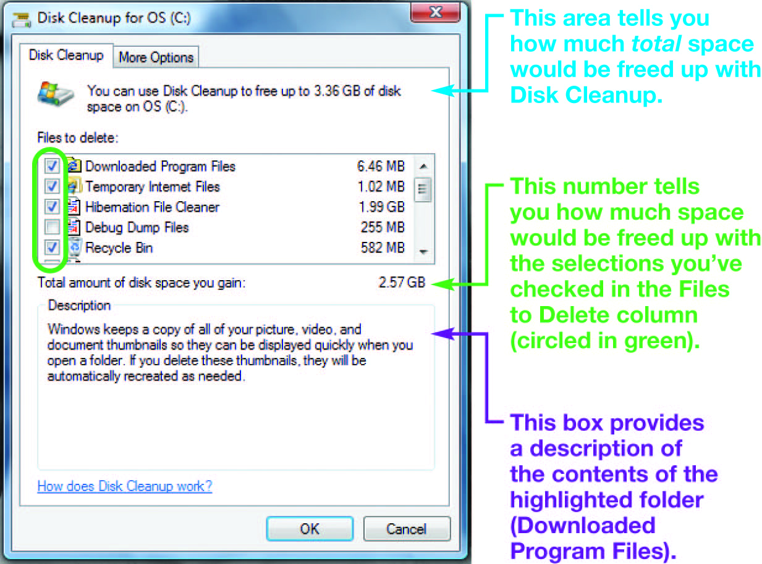
System Maintenance Utilities
Disk Cleanup: Cleans unnecessary files
Notes:
A set of maintenance utilities is built into Windows primarily for system efficiency.
Disk Cleanup cleans unnecessary files from your hard drive. These include files that have accumulated in the Recycle Bin as well as temporary files. If not deleted periodically, these unnecessary files can affect a computer’s performance.

Slide 35
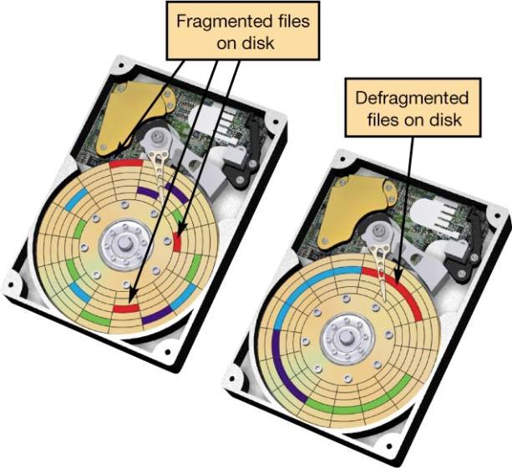
System Maintenance Utilities
Disk defragmenter utilities regroup related pieces of files together on the hard disk, allowing the OS to work more efficiently
ScanDisk:
  Error checker
Task Manager
Notes:
Disk defragmenter utilities regroup related pieces of files together on the hard disk, allowing the OS to work more efficiently. Using the Windows Disk Defragmenter Analyzer feature, users should check their hard drive several times a year.
Error checking, once known as ScanDisk, checks for lost files and fragments as well as physical errors on your hard drive. Sometimes error checking can recover the lost data, but more often, it deletes files that are taking up space unnecessarily.
If a program on your system stops working, you can use the Windows Task Manager utility to check on the program or to exit the nonresponding program.

Slide 36
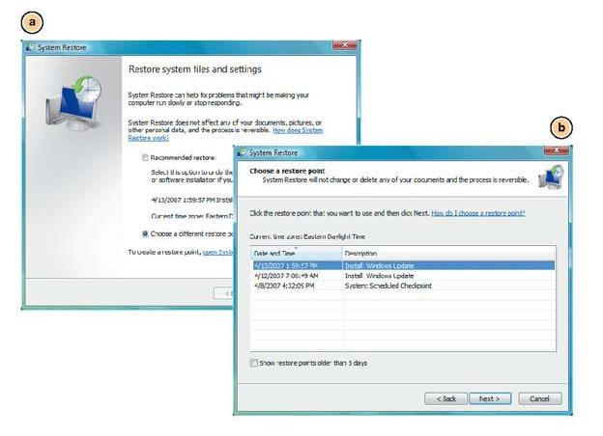
System Restore
Restores system settings to a specific date
Notes:
Windows Vista has a utility called System Restore that lets you restore your system settings back to a specific date when everything was working properly.

Slide 37
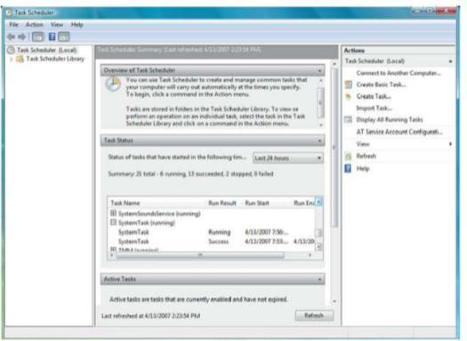
System Backup
Backup
  Creates a copy of a hard drive to another storage device
Task Scheduler
  Runs selected utilities automatically
Notes:
When you use the Windows Backup utility, you create a duplicate copy of all the data on your hard disk and copy it to another storage device, such as a CD or an external hard drive.
The Windows Task Scheduler utility allows you to schedule tasks to run automatically at predetermined times, with no interaction necessary on your part.

Slide 38
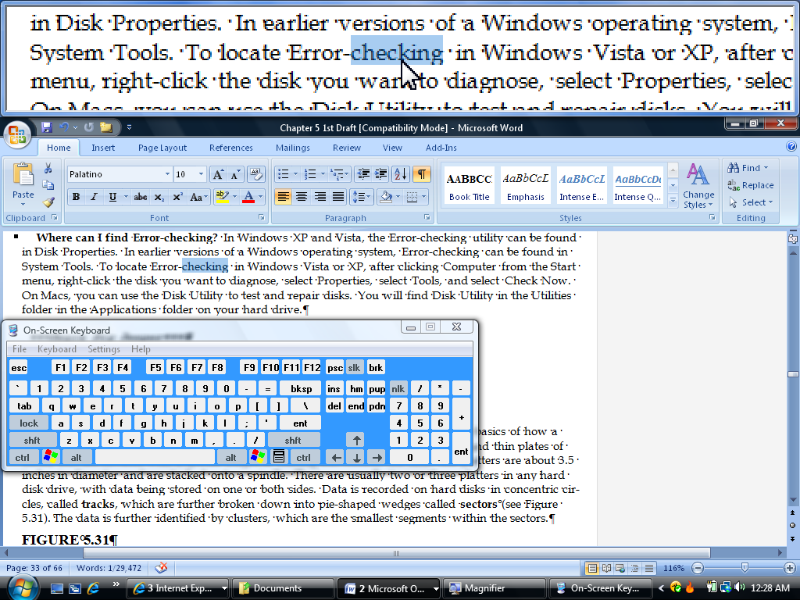
Accessibility Utilities
Ease of Access Center
  Centralized location for assistive technology
  Examples:
    High contrast
    Magnifier
    On-screen keyboard
    Windows speech recognition
Notes:
Windows Vista has created an Ease of Access Center, a centralized location for assistive technology and tools that adjust accessibility settings. In the Ease of Access Center, you can find tools to help you adjust the contrast of or magnify the screen image, have screen contents read to you, and display an on-screen keyboard.

Slide 39
Questions?
“Ask one good question and you will get answers to three.”
― Robert J. Braathe
CIS-101 Computer Information Systems
General Education Core

