Slide 1
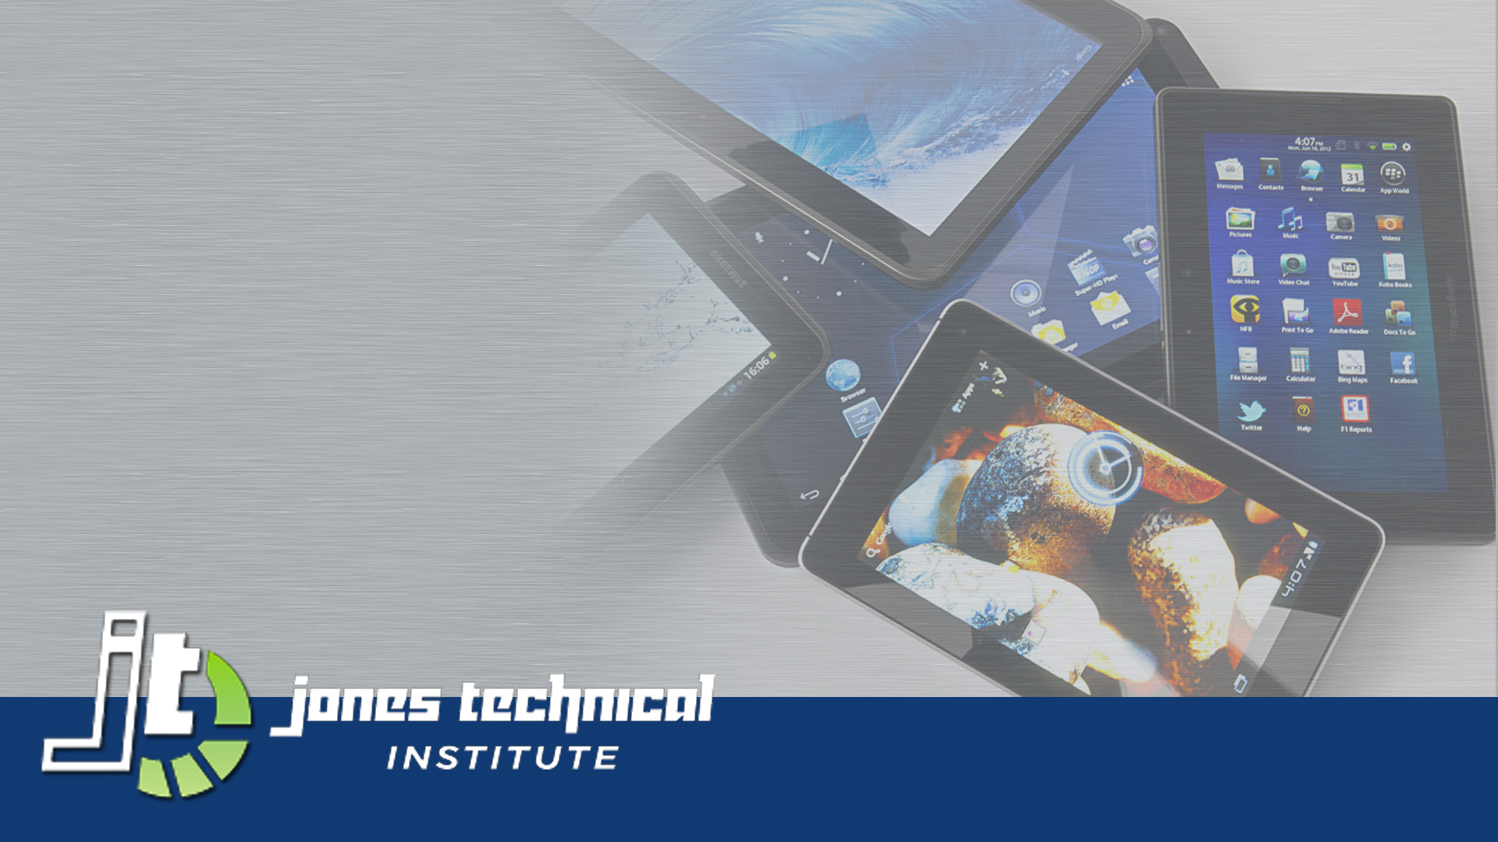
Computer Basics
Deena Sjoberg
CIS-101 Computer Information Systems
General Education Core

Slide 2
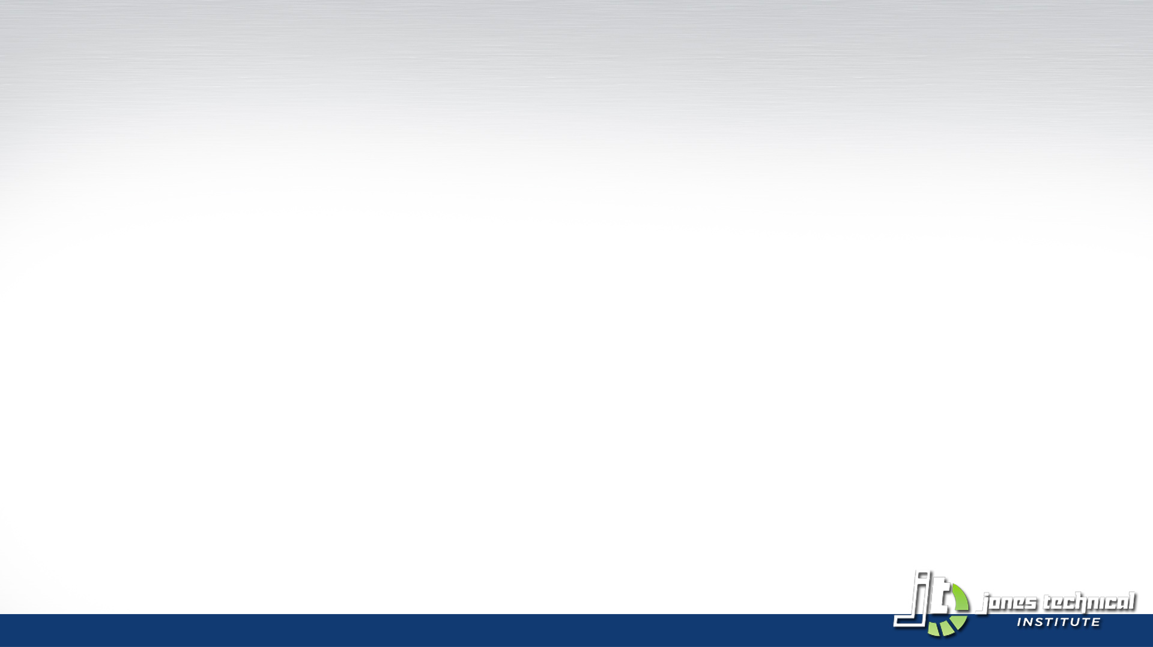
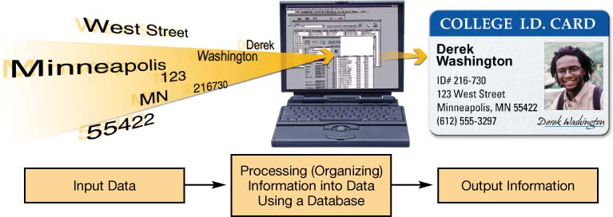
What is Computer Literacy?
To be computer literate, you must:
  Understand a computer’s capabilities and limitations
  Know how to use a computer

Slide 3
Being a Savvy Computer User
and Consumer
Avoid hackers and viruses
Protect your privacy
Understand the real privacy and security risks
Use the Internet wisely
Avoid online annoyances
Maintain your computer
Make good purchase decisions
Integrate the latest technology

Slide 4
Computers in Your Career?
  Business
  Retail
  Shipping
  Arts
  Computer gaming
  Education
  Law enforcement
  Legal system
  Agriculture
  Automotive technology
  Medicine
  Sciences

Slide 5
Computers Are Data
Processing Devices
A computer’s four major functions:
  Gathers data (users input data)
  Processes data into information
  Outputs data or information
  Stores data and information

Slide 6
Bits and Bytes:
The Language of Computers
Bit
  Binary digit
  0 or 1
Byte
  8 bits
Each letter, number, and character = a string of eight 0s and 1s
0000 1111

Slide 7
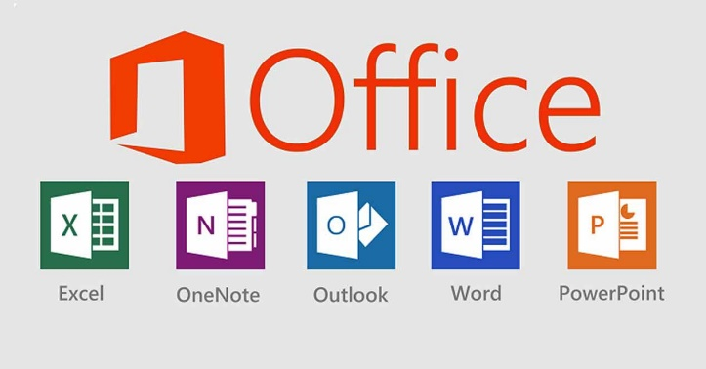


Of Computer Software
Two Major types
Software: Programs that enable hardware to perform different tasks
  Application software
  System software

Slide 8
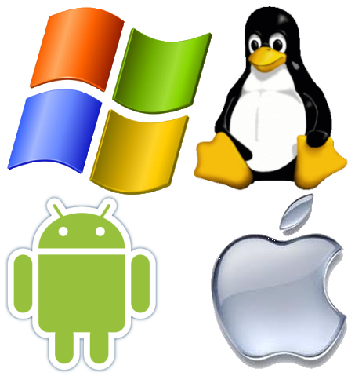
Types of Computers
Windows Based Devices
  Desktop/Laptop/Tablet
  Different Operating Systems
    Windows Operation System
iOS Based Devices
  Desktop/Laptop/Tablet
    Mac Pro
    MacBook Pro
    iPad
Android Based Devices
  Laptop/Tablet/Mobile
    Chromebook
    Cell Phone

Slide 9
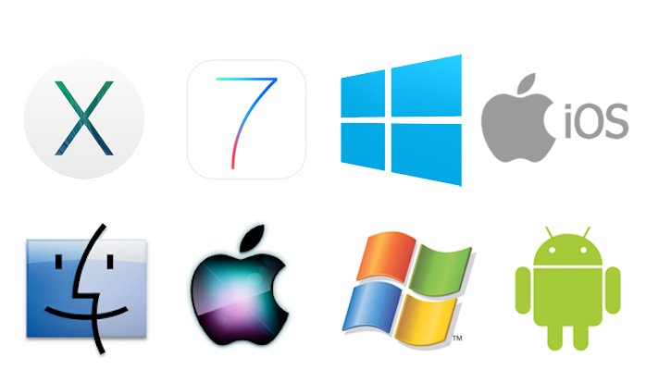
Differences in Operating Systems
Microsoft Based Operating Systems
  Windows XP
  Windows 7
  Windows 8+
  Windows 10
Apple Based Operating System
  iOS 10-10.10.2
  Cheetah, Puma, Jaguar, Panther, Tiger, Leopard, Snow Leopard, Lion, Mountain Lion
  Mavericks, Yosemite
Android Operating System
  Food Based Names
  Cupcake, Donut, Éclair, Froyo, Gingerbread, Honeycomb (Tablet)
  Ice Cream Sandwich, Jellybean, KitKat, Lollipop

Slide 10
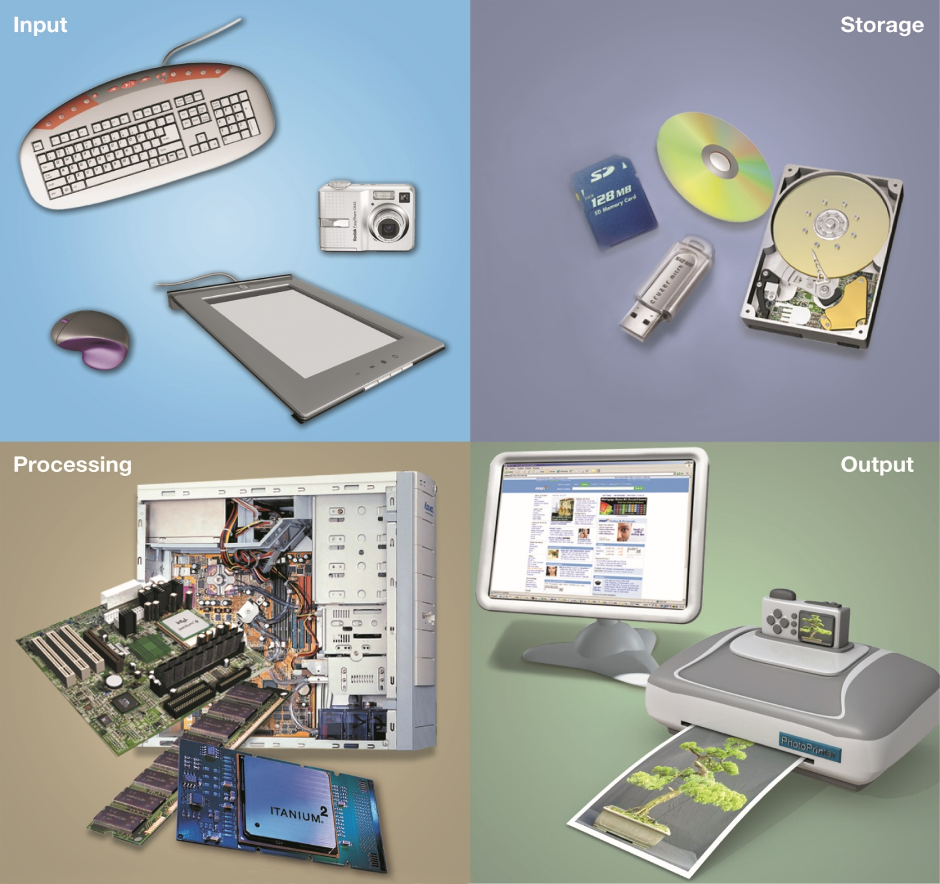
Computer
Hardware

Slide 11
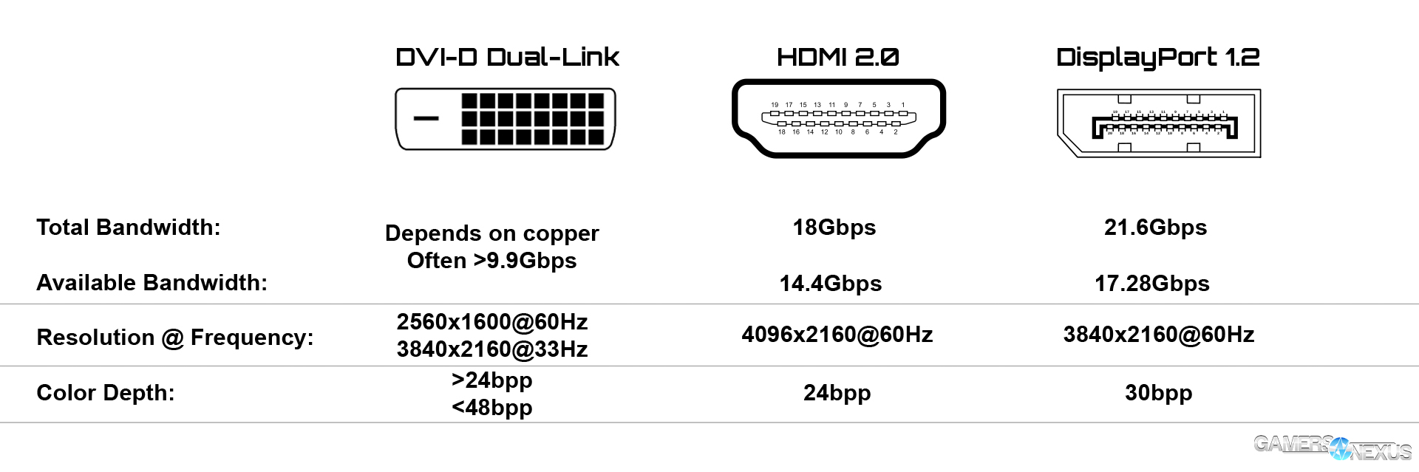
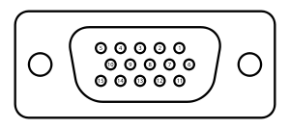
Types of Computer Connections
Display Connections
  VGA
  DVI-D (Mini, Micro)
  HDMI (Full, Mini, Micro)
  DisplayPort (MiniDP)

Slide 12
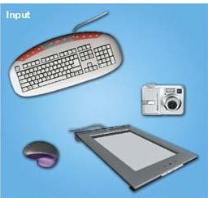
What are some Input Devices?
Devices used to enter information or instructions into the computer
  Keyboard
  Mouse/
  pointing device
  Stylus
  Scanner
  Digital camera
  Microphone
Notes:
12
An input device enables you to enter data (text, images, and sounds) and instructions (user responses and commands) into the computer.
The most common input devices are the keyboard and the mouse.
You use keyboards to enter typed data and commands, whereas you use the mouse to enter user responses and commands by clicking on an icon.
There are other input devices as well: microphones input sounds; scanners and digital cameras input nondigital text and digital images.
Styluses (devices that look like skinny pens but have no ink) and electronic pens are also becoming quite popular and are often used in conjunction with graphics tablets that can translate a user’s handwriting into digital input.

Slide 13
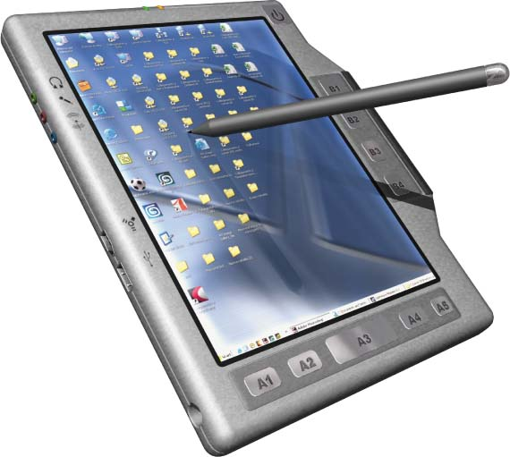
Specialty Keyboards
Notebook keyboard
PDA stylus
Tablet PCs
Wireless keyboard

Slide 14
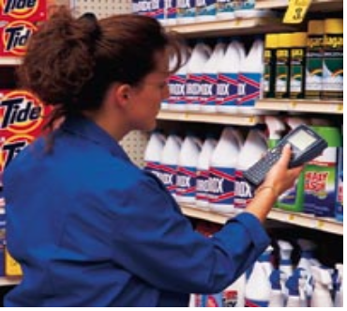
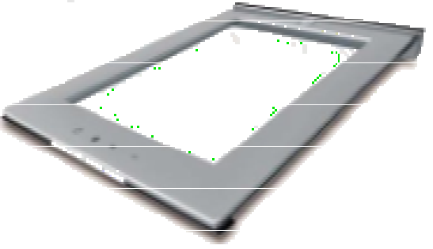
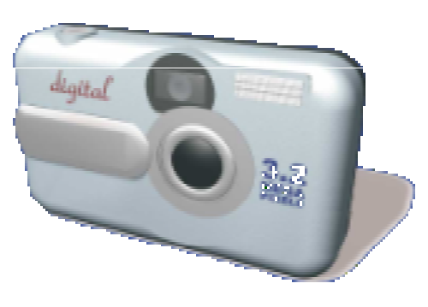
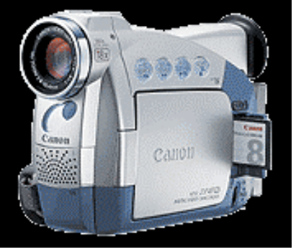
Other Input Devices
Scanners
  Text
  Images
Digital cameras
  Images
  Video
Flatbed scanner
Handheld scanner
Digital camera
Camcorder
Notes:
12
An input device enables you to enter data (text, images, and sounds) and instructions (user responses and commands) into the computer.
The most common input devices are the keyboard and the mouse.
You use keyboards to enter typed data and commands, whereas you use the mouse to enter user responses and commands by clicking on an icon.
There are other input devices as well: microphones input sounds; scanners and digital cameras input nondigital text and digital images.
Styluses (devices that look like skinny pens but have no ink) and electronic pens are also becoming quite popular and are often used in conjunction with graphics tablets that can translate a user’s handwriting into digital input.

Slide 15
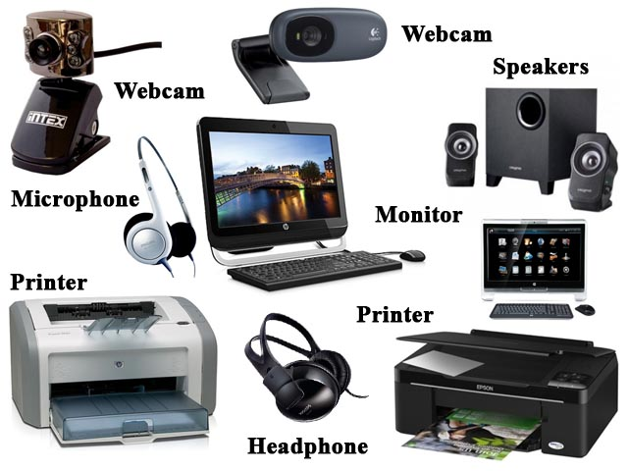
What are some Output Devices?
Send processed data out of the computer
  Monitors
  Printers
Output devices make:
  Soft copies (video, sounds, control signals)
  Hard copies (print)
Notes:
12
An input device enables you to enter data (text, images, and sounds) and instructions (user responses and commands) into the computer.
The most common input devices are the keyboard and the mouse.
You use keyboards to enter typed data and commands, whereas you use the mouse to enter user responses and commands by clicking on an icon.
There are other input devices as well: microphones input sounds; scanners and digital cameras input nondigital text and digital images.
Styluses (devices that look like skinny pens but have no ink) and electronic pens are also becoming quite popular and are often used in conjunction with graphics tablets that can translate a user’s handwriting into digital input.

Slide 16
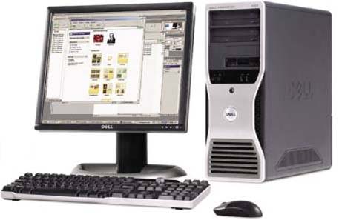
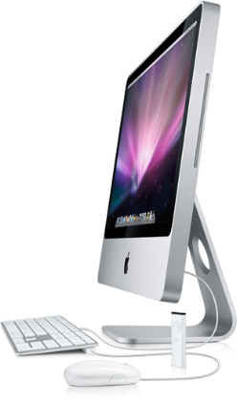
The System Unit
Box that contains the central electronic components of the computer:
  CPU/RAM/
  motherboard
  Expansion cards
  Power supply
  Storage devices
Notes:
12
The system unit is the box that contains the central electronic components of the computer, including the computer’s processor, memory, and circuit boards.
You’ll also find the power source and all the storage devices (CD/DVD drive and hard drive) in the system unit.
In a notebook computer, the system unit, monitor, and keyboard are combined into a single unit.

Slide 17
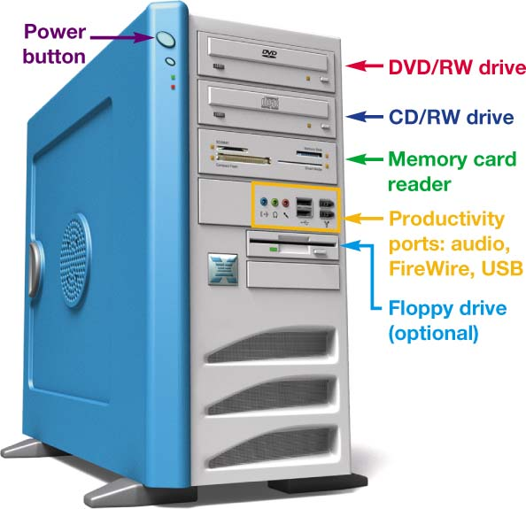
The Front Panel
Power control
Drive bays
Memory card reader
Productivity ports
Notes:
12
The front panel of your computer provides you with access to power controls as well as to the storage devices on your computer.
Drive bays are special shelves reserved for storage devices. Some drive bays are internal (cannot be seen from outside the system unit) and others are external, such as CD and DVD drives.
Some PCs include memory card readers and productivity ports on the front, including USB and FireWire, used for peripherals and image downloading.

Slide 18

Computers in Automotive Technology
Environmental trends and government regulations
Computerized sensors and CPU systems in vehicles
Consumer demand for computerized subsystems
Notes:
Environmental trends and government regulations influence the use of technology in vehicles.
Automotive technicians diagnose and research problems with computerized sensors and CPU systems in vehicles using computers, databases, and the Internet.
Consumer demand for computer subsystems like GPS navigation, digital music systems, and voice-controlled phones continues to grow.

Slide 19
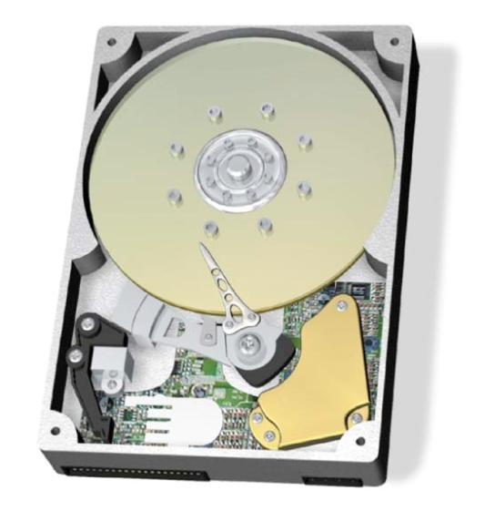
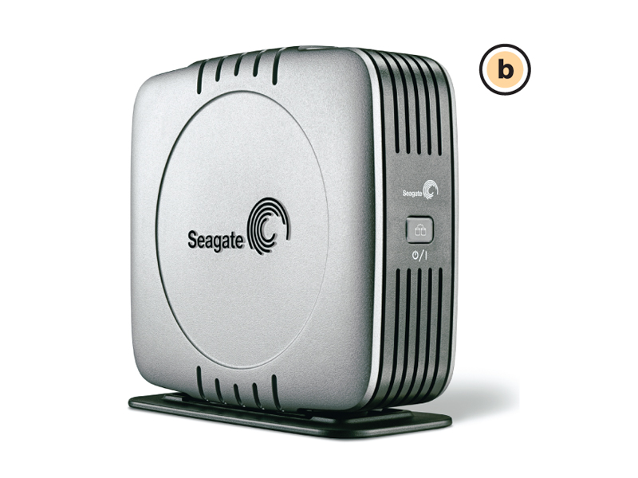
Hard Disk Drives

Slide 20
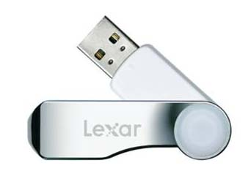
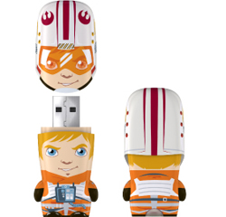
USB/Flash Drives/Flash Memory
Flash drives (jump drives)
  Newer storage alternative
  Plug into USB ports
Flash memory cards
  Slide into slots in the system
Notes:
Flash drives, sometimes referred to as jump drives, USB drives, or thumb drives, are the new alternative to storing portable data. They plug into USB ports.
Several manufacturers now also include slots on the front of the system unit in which you can insert portable flash memory cards. Many notebooks also include slots for flash memory cards. Flash memory cards let you transfer digital data between your computer and devices such as digital cameras, PDAs, smartphones, video cameras, and printers.

Slide 21
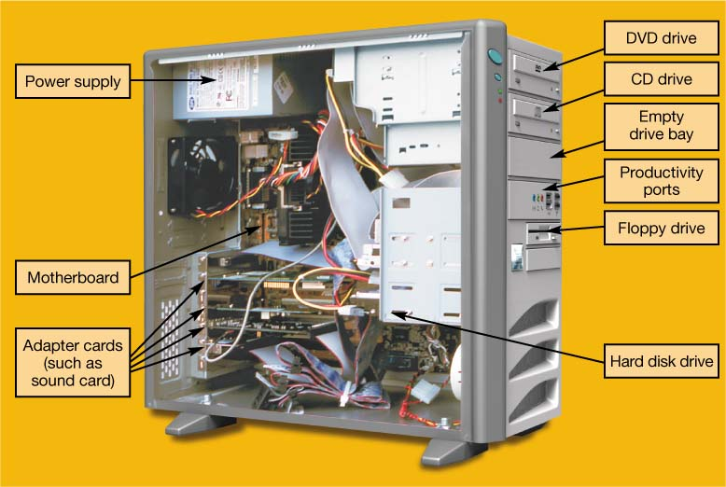
Inside the System Unit
Essential electronic components used to process data
Types of components:
  Power supply
  Hard disk drive
  Motherboard
  CPU
  Expansion cards
Notes:
The system unit contains the essential components of a computer. Inside are the power supply, motherboard, RAM, storage drives, expansion cards, and central processing unit. Today’s personal computer follows the same design concept as IBM’s first PC in 1981 did. All the components have evolved, but the foundation and concepts are the same.

Slide 22
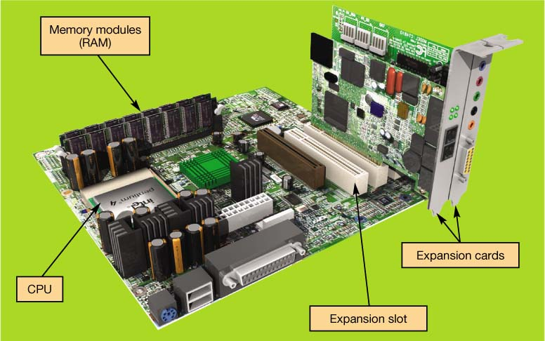
The Motherboard
CPU
RAM
Expansion cards and slots
Built-in components
Notes:
The motherboard is the key circuit board holding the essential processing parts. Attached directly to the motherboard are the CPU, RAM, expansion cards, and in many new computers, networking, modem, video, and audio components.

Slide 23
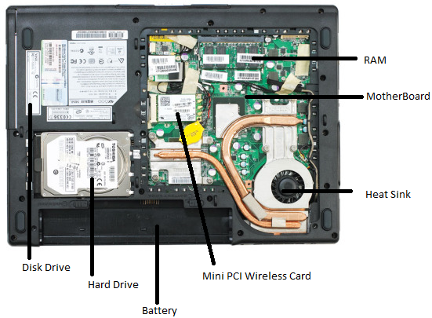
The Laptop
RAM
Motherboard
Heat Sink and Fan
Hard Drive
Battery
Notes:
The motherboard is the key circuit board holding the essential processing parts. Attached directly to the motherboard are the CPU, RAM, expansion cards, and in many new computers, networking, modem, video, and audio components.

Slide 24
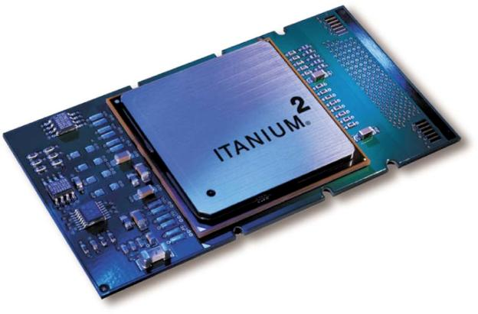
Central Processing Unit (CPU)
Referred to as the “brains” of the computer
Controls all functions of the computer
Processes all commands and instructions
Can perform billions of tasks per second
Notes:
The central processing unit (CPU, or processor) is the largest and most important chip in the computer.
It is sometimes referred to as the “brains” of the computer because it controls all the functions performed by the computer’s other components and processes all the commands issued to it by software instructions.
Modern CPUs can perform three billion tasks a second without error, making them extremely powerful components.

Slide 25
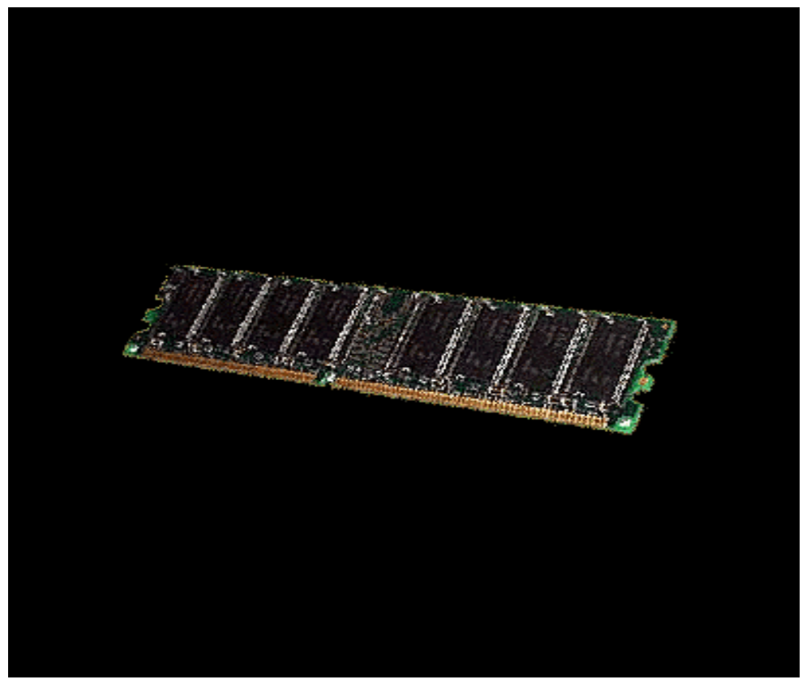
Memory Module
Random access memory (RAM)
Stores instructions and data
Temporary (volatile) storage
Operates in nanoseconds
Notes:
Random access memory (RAM) is a series of small cards plugged into slots on the motherboard. The CPU can request any data in RAM. It is then located, opened, and delivered to the CPU for processing in a few billionths of a second.
Because all the contents of RAM are erased when you turn off the computer, RAM is the temporary or volatile storage location for the computer.
To save data more permanently, you need to save it to the hard drive or to another permanent storage device such as a floppy disk, CD, or flash drive.

Slide 26
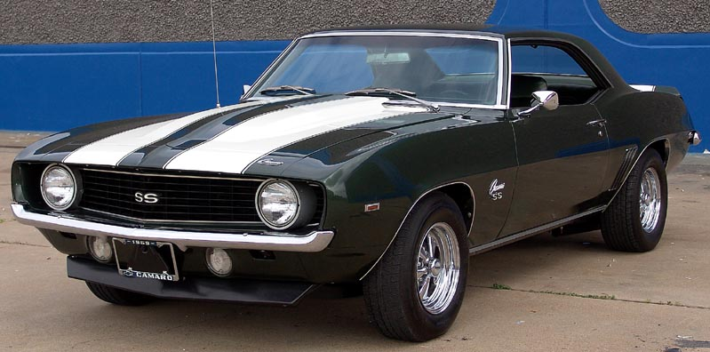
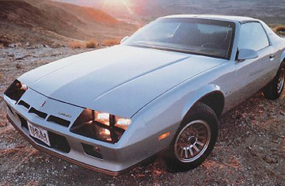
The Beginning of Car Computers
1970s Was the beginning of the EPA and regulations to clean up the environment.
In the late 1970s car manufactures were under pressure to increase fuel mileage and decrease pollution by the California Clean Air Act.
Manufactures moved towards Fuel injection based systems which require computers to control the system. Virtually all cars by the 1980s where fuel injected.

Slide 27
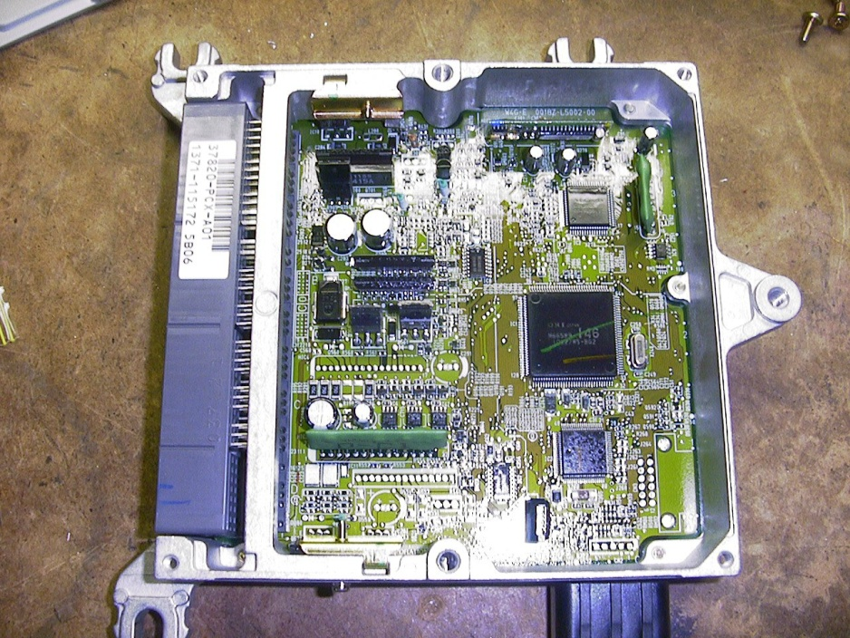
Electronic Control Unit (ECU)
An ECU is an embedded system that controls/monitors systems in a car.
Combination of ECUs is known as the cars computer.
The cars “computer” is not one system but a large number of small subsystems connected together by a network.
Modern vehicles have up to 75+ ECUs.

Slide 28
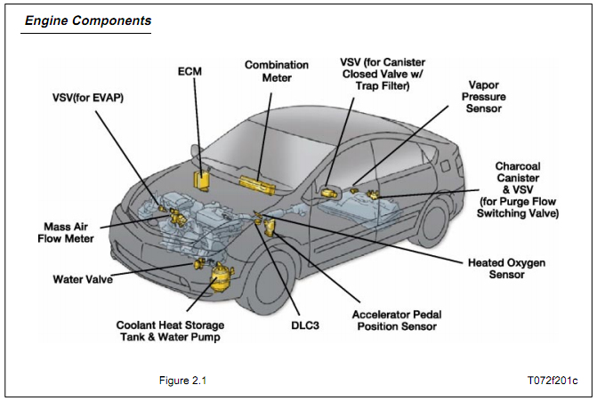
Typical ECUs
Engine Control Module (ECM) – Determine parameters for an Internal combustion engine.
Electronic Stability Control (ESC) – Improves vehicle safety by preventing loss of control.
Anti-Lock Braking System (ABS) – Improves safety by preventing the brakes from locking.

Slide 29
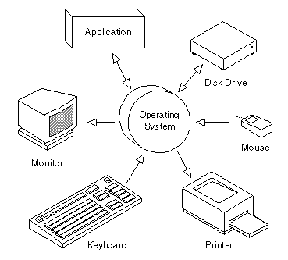
A typical PC Operating System arena of peripheral device control

Slide 30
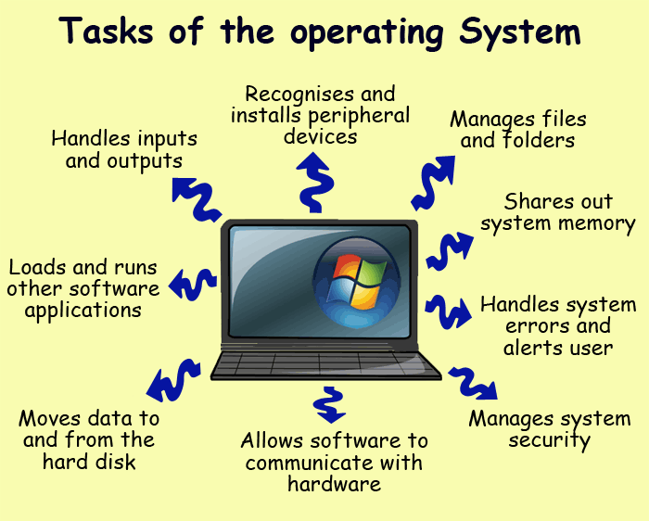
Typical Control of the
Operating System

Slide 31
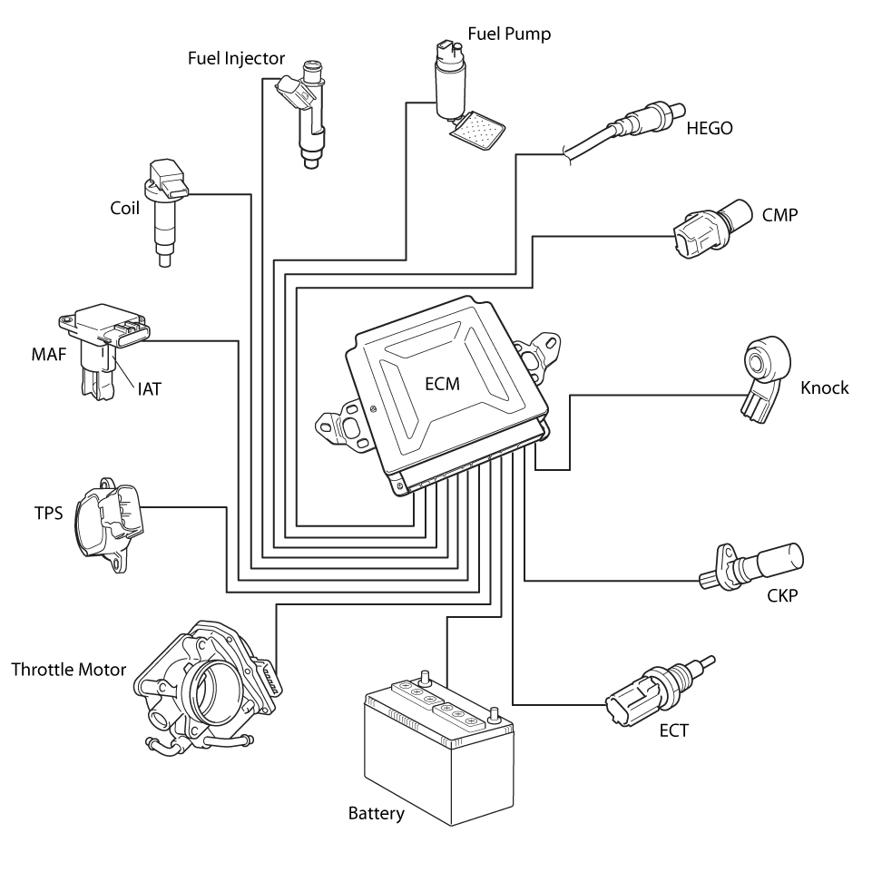
The Engine Control Module ECM

Slide 32
Electronic Control Module
Controls the parameters of an internal combustion engine.
Has developed into a closed-loop system, feeds data back into the car to make decisions
Embedded System, resources are limited.
  Early systems entirely look-up table based.
  Current designs are able to compute many parameters on-the-fly but there is still a few look up tables.

Slide 33
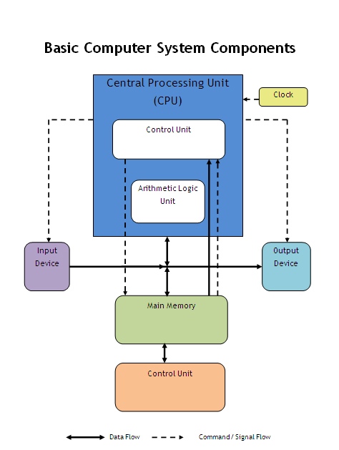
The Computer’s
Central Processing Unit - CPU

Slide 34
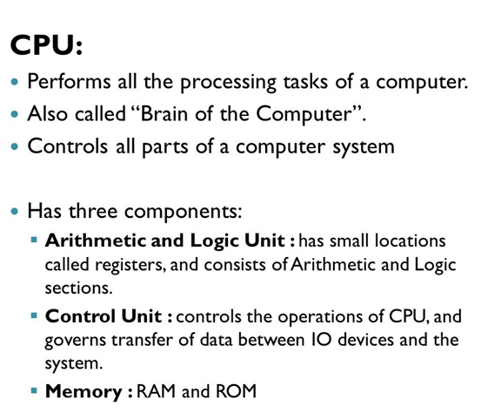
Computer - Central Processing Unit

Slide 35
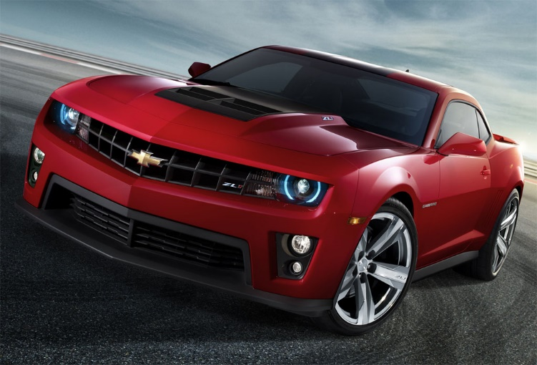
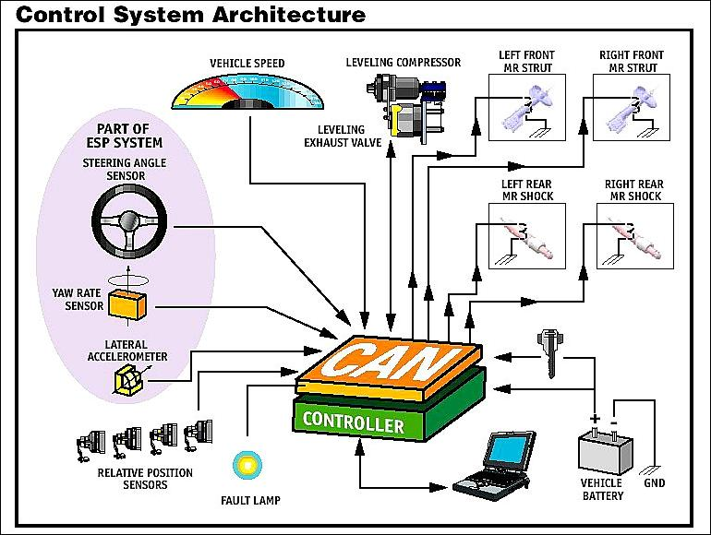
Modern ECUs
Drive-by-Wire
Variable Control Transmissions
Magnetic Dampers

Slide 36
Controller Area Network (CAN)
VS. Local Area Network (LAN)
Controller–area network (CAN or CAN-bus) is a vehicle bus standard designed to allow microcontrollers and devices to communicate with each other within a vehicle without a host computer.
Local Area Network (LAN) is a computer network that interconnects computers within a limited area such as a residence, school, laboratory, university campus or office building and has its network equipment and interconnects locally managed.
By contrast, a Wide Area Network (WAN), not only covers a larger geographic distance, but also generally involves leased telecommunication circuits or Internet links. An even greater contrast is the Internet, which is a system of globally connected business and personal computers.

Slide 38
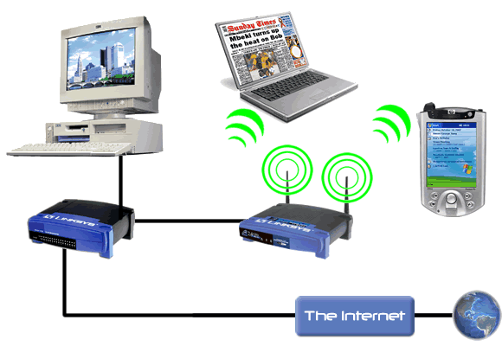
Types of Computer Connections (cont’d)
Network Connections
  Wired
    RJ-45
  Wireless
    802.11 a/b/g/n
    802.11 ac
    Bluetooth
Data Input/Output Connections
  Parallel, Serial, PS/2 Connections
  Firewire, Thunderbolt, Lightning
  USB

Slide 39
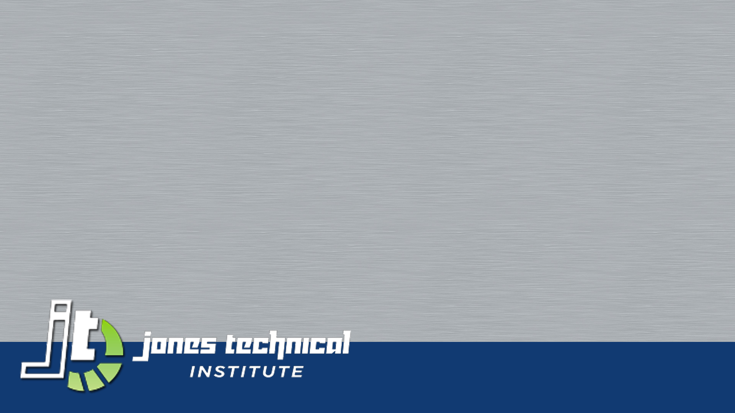
Best Practices
How to Fix What You Did or Didn’t Do
CIS-101 Computer Information Systems
General Education Core

Slide 40


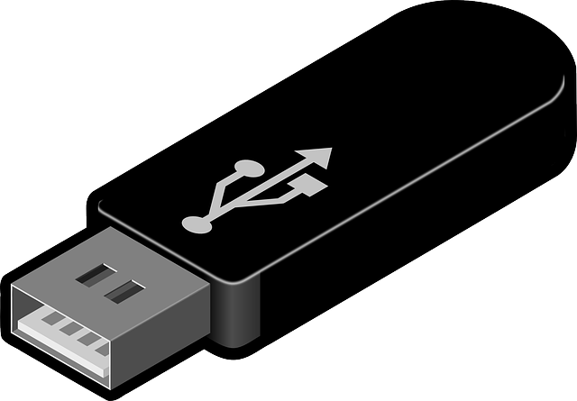
What Am I Doing Wrong?
Multiple Copies of Files
  Located in Different Locations
Saving Frequently
  Setup Microsoft Office for Auto-Save
  Every Hour at Minimum
Draining Battery
  Battery Memory
  Full Draining on Occasion

Slide 41
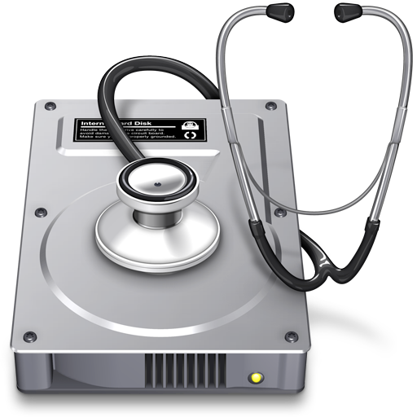
How Did I Do that?!
Virus Issues
  Pop-ups
  Slowness, but is it a virus?
  Random Fan Noise
  I lost all my files?!
Types of Viruses
  What is a virus?
    Malware
    Spyware
    Ransomware
Prevention
  Website Issues
  Spam
Remediating Viruses
  Antivirus Software
  Removal Tools
    Spyware A&D
    AdAware
    SuperAntiSpyware
    Spyware Blaster

Slide 42
Your ASUS Tablet
CIS-101 Computer Information Systems
General Education Core

Slide 43
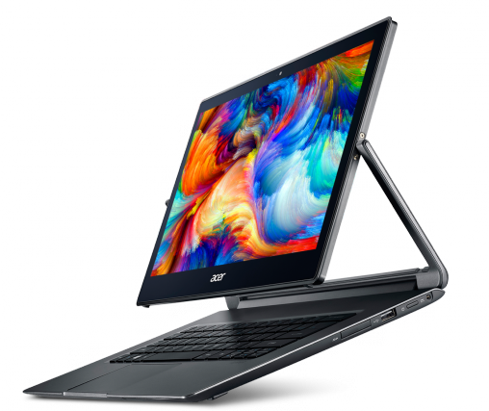
What Defines a Tablet?
Tablet is a Form, Not a Type
  Convertible
  Slate
  Hybrid
Multiple Manufacturers
Tablet Operating Systems
  Android
  Windows
  iOS

Slide 44
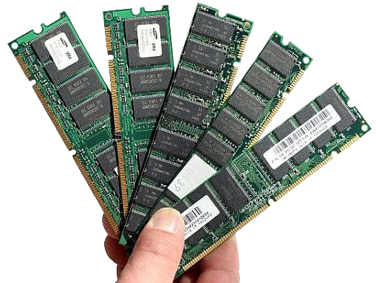
Design of the Device
Types of Ports
  Mini-HDMI
  Micro-USB
  USB Port
  Docking Port
  Micro-SD Slot
Types of Processors
  Intel ATOM
  Intel Core Duo
  Intel Core i3, i5, i7
Types of Storage
  Solid State Storage
    Internal
    External
  Spinning Disk
Types of Memory
  RAM
  ROM

Slide 45
Accessory Functions of ASUS Tablet
Function Buttons
FN + F1
  Put Tablet to Sleep
FN + F2
  Wireless On/Off
FN + F5
  Brightness Decrease
FN + F6
  Brightness Increase
FN + F8
  External Display On/Off
FN + F9
  Disable Touchpad
FN + F10
  Mute Sound
FN + F11
  Decrease Sound Volume
FN + F12
  Increase Sound Volume

Slide 46
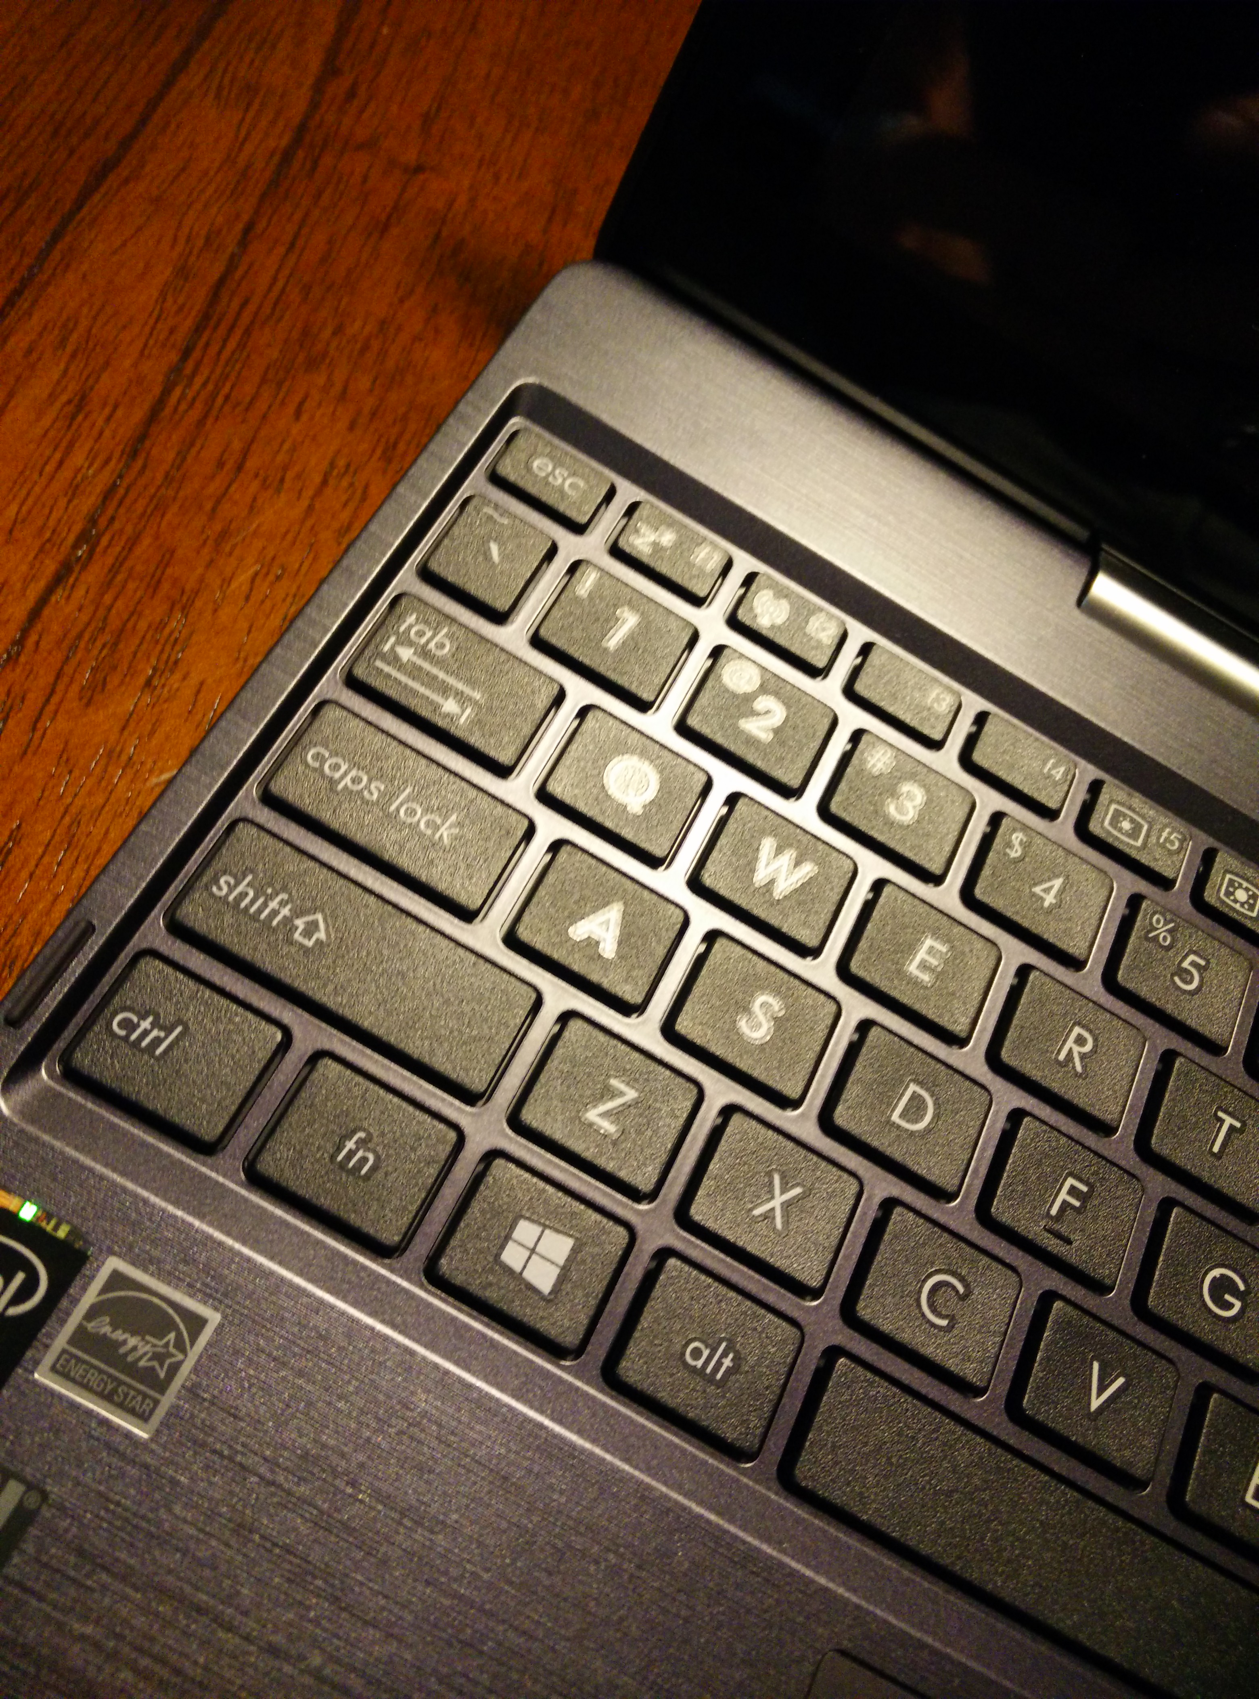
Function Buttons (FN + F?)

Slide 47
Multi-Touch Gestures
Pan
  Use two fingers to scroll in the desired direction.
Zoom
  Use multiple fingers to pinch or expand an object.
Rotate
  Use two fingers to rotate in the desired direction.
Press and tap
  Press an object and tap with an accessory finger for right clicking.
Universal Standard on Most Devices
  Android
  Windows 8+ (Touchscreen or Pad)
  iOS (Mobile Device or Pad)

Slide 48
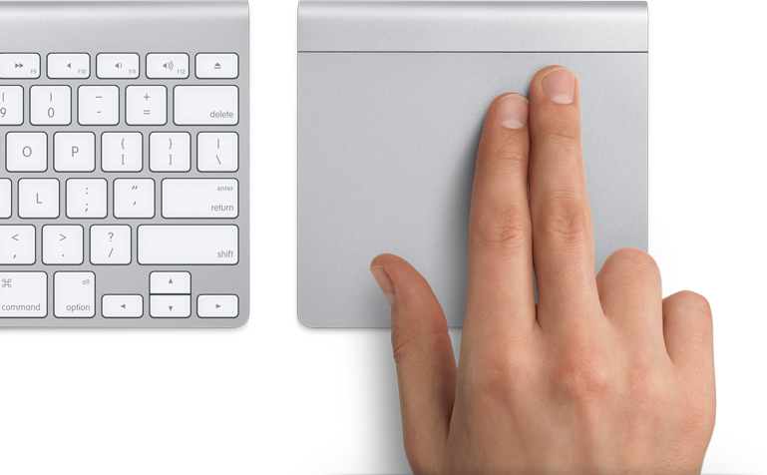
Multi-Touch Gestures Illustrated

Slide 49
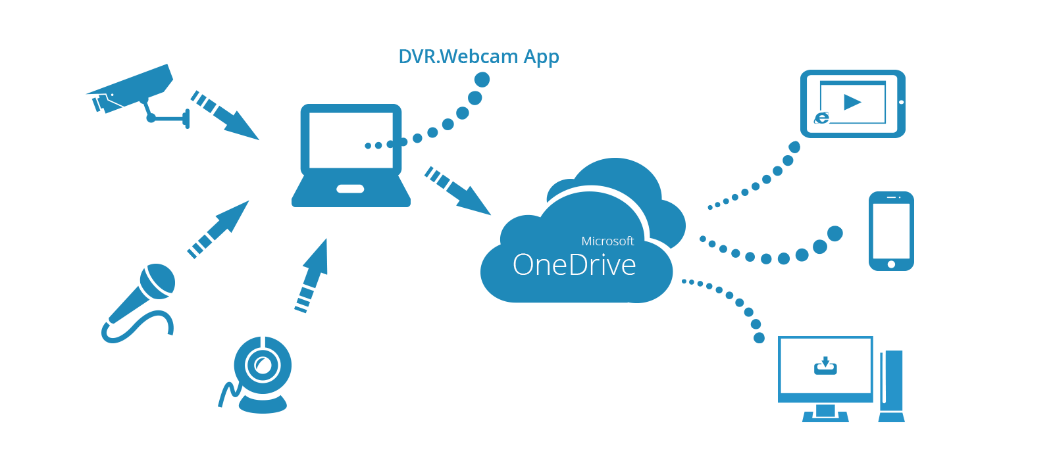
Setting Up Tablet
Signing Up for a Windows Live Account
  OneDrive (Skydrive)
  Outlook Email Account
  Unified Look/Feel
  Device Tracking
Setting Up Wireless
  Connecting to a WAP
  Saving Connection
  Encryption and Public Access Points

Slide 50
Questions?
“Ask one good question and you will get answers to three.”
― Robert J. Braathe
CIS-101 Computer Information Systems
General Education Core

