Slide 1
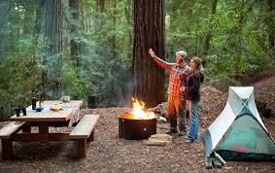
Camping
Enjoying the Outdoor Life
Notes:
It is fun to camp. Make sure to be mindful of your fires and neighbors. Keep food out of tents.

Slide 2
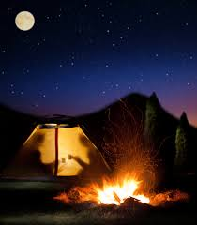
Mountain Camping
Bring warm clothing
Do not bring food into the tent
Keep fires contained
Notes:
While camping in the wilderness and mountain areas, be careful of the wildlife. Hang food far away from the tent.

Slide 3
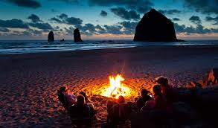
Beach Camping
Bring warm clothing
Place tent in a high area
Keep fires contained
Notes:
While camping, be aware of high tide. Don’t swim in the dark. Watch for undertows.

Slide 4
The Benefits of Camping
Beauty
Family
Nature
Rest
Fresh Air
Notes:
There are many benefits to camping. The outdoors are a good place for the family to get rest and fresh air, enjoy each other and the beauty of nature together.

